Slide 1
SUICIDE PREVENTION ON COLLEGE CAMPUSES
DEVELOPED BY: CRISTINA RITA, MA

Slide 2
LEARNING OBJECTIVES
By the end of the presentation, the participant will be able to:
Understand the scope of suicide
Identify suicide risk factors and warning signs
Learn how to ask about suicide and what steps to take when someone is experiencing emotional distress.

Slide 3
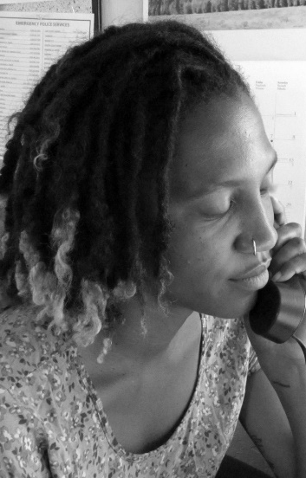
LOCAL SUICIDE PREVENTION RESOURCES
Crisis Support Services of Alameda County
24/7 Crisis Line
988 or 1800-309-2131
Youth Textline
Text SAFE to 20121 (8a-12a Daily)
For Spanish: Text SEGURO to 20121 (5p – 9pm Tues-Fri)
Para Español: Textear SEGURO al 20121 (5 pm - 9 pm martes - viernes)
NATIONAL RESOURCES
988 Suicide & Crisis Lifeline (24-Hours)
988 *press 1 for Veterans, press 2 for Spanish
Crisis Textline
Text BRAVE to 741-741 (24-Hours)

Slide 4
Mental Health on College Campuses

Slide 5
What is Mental health?
Mental health includes our emotional, psychological, and social well-being. It affects how we think, feel, and act.
It also helps determine how we handle stress, relate to others, and make healthy choices.
Mental health is important at every stage of life, from childhood and adolescence through adulthood.
(Retrieved from: https://www.cdc.gov/mentalhealth/learn/index.htm)

Slide 6
Mental Health on college campuses
According to 2021 Healthy Minds Study mental health challenges are common on college campuses.
The most common mental health challenges are:
Major depression 41%
Anxiety 34%
Lifetime diagnoses of mental disorder 40%
Mental health therapy/counseling (past year) 30%
Perceived public stigma: agrees with ‘Most people would think less of someone who has received mental health treatment 45%
Suicidal ideation (past year) 13%

Slide 7
Mental health Survey Data

Slide 8
COVID-19 & COLLEGE MENTAL HEALTH
Approximately 70% of college students experienced increased stress and anxiety due to COVID 19
Multiple stressors were identified that contributed to increased levels of stress, anxiety, depression and suicidal ideation:
Fear and worry about their own health and of their loved ones health
Disruptions to sleeping patterns
Decreased social interactions due to physical distancing
Difficulty concentrating
Increased concerns about academic performance
To cope with the increased stress and anxiety there has been an increase in of both negative and positive coping skills.
(Son, C., Hegde, S., Smith, A., Wang, X., & Sasangohar, F. (2020). Effects of COVID-19 on College Students' Mental Health in the United States: Interview Survey Study. Journal of medical Internet research, 22(9), e21279. https://doi.org/10.2196/21279

Slide 9
THE SCOPE OF THE PROBLEM

Slide 10
Defining Terms
Term | Definition
Suicide | Death caused by self-directed injurious behavior with any intent to die as a result of the behavior.
Suicide Attempt | A nonfatal self-directed potentially injurious behavior with any intent to die as a result of the behavior. A suicide attempt may or may not result in injury.
Suicidal Ideation | Passive thoughts about wanting to be dead or active thoughts about killing oneself, not accompanied by preparatory behavior.
Suicidal Behavior | Includes suicide, suicide attempts, other suicidal behavior, and preparatory acts.
Self-Harm | An act with nonfatal outcome, in which an individual deliberately initiates a nonhabitual behavior that, without intervention from others, will cause self-harm.
O’Connor E, Gaynes B, Burda BU, et al. Screening for Suicide Risk in Primary Care: A Systematic Evidence Review for the U.S. Preventive Services Task Force [Internet]. Rockville, (MD): Agency for Healthcare Research and Quality (US); 2013 Apr. (Evidence Syntheses, No. 103.)

Slide 11
Tips for talking about suicide
Consider Saying
Instead Of
Suicide attempt/attempted suicide
Died by suicide/suicide death
Took their own life
Died as the result of self-inflected injury
Failed suicide or unsuccessful attempt
Successful or completed suicide
Committed suicide
Chose to kill him/herself
When talking about suicide, consider other meanings your words may have. For example, “committed suicide” implies that suicide is a crime. Choosing words that are clearer and more neutral help reduce stigma.
Retrieved from National Alliance on Mental Illness (NAMI) Language Matters https://nami.org/NAMI/media/NAMI-Media/Infographics/NAMI-Language-Matters.pdf

Slide 12
Suicide Statistics, U.S. 2020
45,979 people died by suicide in 2020 in the U.S. making suicide the 12th cause of death in the U.S.
Suicide is the second-leading cause of death for ages 10-34 (CDC,2022)
Approximately 1,200 college students die by suicide each year
CDC, 2020; Garnett, M.F., Curtin, S.C., & Stone, D.M (2020). Suicide Mortality in the United States, 2000-2020. Retrieved from; https://cdc.gov.nchs/products/index.htm.

Slide 13
SUICIDE RISK IN DIVERSE COMMUNITIES
Suicide is a complex issue. There is never one reason why a person may attempt or die by suicide.
Often it is a combination of circumstances that contribute to the risk of suicide.
Understanding racial, ethnic, and gender differences in rates of suicidal ideation, suicide attempts, and suicide deaths is essential for more effectively directing and guiding suicide prevention efforts.
In addition to general risk factors experienced by their cisgender counterparts, transgender people have additional risk factors, such as experiences of discrimination, stigma, family and societal rejection, and lack of access to gender-affirming health care.
Racial and ethnic groups differ in their access to culturally appropriate behavioral health care, experiences of discrimination, historical and inter-generational trauma, and other factors that may be related to suicide risk.
At the same time, our understanding of racial, ethnic, and gender differences in suicide deaths and suicidal behaviors is limited by underreporting and other limitations in data collection systems.

Slide 14
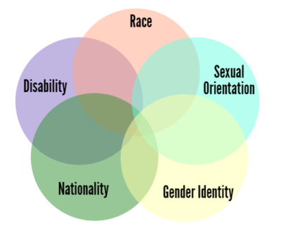
INTERSECTIONALITY AND SUICIDE
Introduced by Kimberle Crenshaw as an idea that, “when it comes to thinking about how inequalities persist, categories like gender, race, and class are best understood as overlapping...rather than isolated and distinct”
According to Crenshaw, these inequalities “operate together and
exacerbate each other”
We have many facets to our identity and it’s what makes us unique.
When individuals experience the convergence of inequalities and other adverse experiences (ex. systemic racism, institutional violence, homophobic and transphobic violence, ageism, classism, ableism..etc) based on the multiple identities they hold, the impact is compounded and can lead to physical and mental health disparities, including an increased suicide risk.
(Image credit: YW Boston Blog, 2017)

Slide 15
THE SUICIDAL MIND

Slide 16
What stops us from talking about suicide with students?
What might stop a student from talking to us about their suicidal feelings?

Slide 17
COMMON ANSWERS
What stops us from talking about suicide?
Fear, shame guilt
Putting the idea of suicide in the persons mind
Not knowing what to do if the person says yes
My personal beliefs about suicide
What might stop a client from talking to us about their suicidal feelings?
Fear, shame, guilt
Stigma about suicide and help seeking
Not knowing how to talk about difficult feelings
Being hospitalized

Slide 18
Kevin Hines: I jumped from the Golden gate bridge

Slide 19
Recognizing suicide behavior
Photo by Nik Shuliahin on Unsplash

Slide 20
EVENTS THAT CAN CONTRIBUTE TO SUICIDAL BEHAVIOR
Changes in families, such as divorce, siblings moving out, moving to a new town
Changes in relationships - problems with friends, romantic relationships
Problems at school – academic, social problems
Major disappointment
Child maltreatment – sexual, emotional, physical abuse
Mental health disorders
Social failure
COVID 19 – Loss, missing critical events, isolation and grief and loss.
(Weir, K. (Dec 2016). Research on suicide overlooks young children; psychologist are working to change that. American Psychological Association vol 47, No, 11. Retrieved 18 Feb 2020 from: https;//www.apa.org/monitor/2016/12/ce-corner. Stanford Children’s Health/Lucile Packard Children’s Hospital Stanford (2020). Teen Suicide. Retrieved 17 Feb 2020 from: https://www.stanfordchildrens.org/en/topic/default?id=teen-suicide-90-P02584).

Slide 21
SUICIDE RISK FACTORS (CDC,AFSP.ORG)
Personal or family experience with trauma, violence or intergenerational trauma
Lack of acceptance by family, friends, and community regarding gender identity and/or sexual orientation
Family history of suicide, history of suicide attempt(s)
Social isolation, exclusion or history of aggressive or antisocial behavior
Childhood maltreatment
Institutional discrimination, violence, racism
Access to lethal means coupled with suicidal thoughts.
Recent discharge from psychiatric hospital.
Barriers to health care
Recent life stressor

Slide 22
ACUTE WARNING SIGNS OF SUICIDE
These might be remembered as expressed or communicated ideation. If observed, seek help as soon as possible by contacting a mental health or medical professional or the
National Suicide Crisis Line at 988
Threatening to hurt or kill him or herself, or talking of wanting to hurt or kill him/herself.
Looking for way to kill him/herself by seeking access to firearms, pills, or other means.
Talking or writing about death, dying or suicide when these action are out of the ordinary.
These might be remembered as expressed or communicated ideation.
(American Association of Suicidology (nd). Retrieved 11/30/18 from: https://www.suicidology.org/resources/warning-signs).

Slide 23
ADDITIONAL SUICIDE WARNING SIGNS
Rage, uncontrolled anger, seeking revenge
Acting reckless or engaging in risky activities, seemingly without thinking
Dramatic mood changes
Sleep disturbances
Feeling like a burden
Giving away personal possessions
Increased use of substances
No reason for living, no purpose in life
Anxiety, agitation, aggression
Feeling trapped - like there is no way out
Feeling hopeless, worthless, loneliness
Withdrawal from family, friends, and social activities,

Slide 24
STATEMENTS TO PAY ATTENTION TO
Examples of statements that a student may say when experiencing suicidal thoughts or feelings. When heard help should be offered.
“It’s just so hard to get out of bed lately.”
"I just can’t deal with life right now.”
”I want to go to sleep and never wake up.”
“Everything is too much.”
”I feel like nothing is ever going to change. My life will always be terrible.”
”I don’t want to live anymore.”

Slide 25
Protective Factors
Protective factors may help mitigate the crisis.
However protective factors, when present, may not counteract significant suicide risk.
Protective factors are personal or environmental characteristics that help protect people from suicide.
Major protective factors for suicide include:
Effective behavioral and physical health care
Feelings of connectedness to individual's, family, community and social institutions
Participating in religion or a spiritual practice
Having social and emotional support
Being involved in community programs
Having hope
Positive ethnic identity
(Suicide Prevention Resource Center, & Rodgers, P. (2011). Understanding risk and protective factors for suicide: A primer for preventing suicide. Newton, MA: Education Development Center, Inc.)

Slide 26
HOW to help

Slide 27
BEFORE YOU BEGIN…
Take a deep calming breath.
The emphasis is on the students experience and feelings.
Be prepared to listen, put away any distractions.
Let individual know you are there to help and that you care.
Be persistent. It is okay to ask about suicide more than once.
Try not to argue, distract or cheer-up the individual.
Remain attentive, open body language, comfortable eye contact. Even when using technology to connect this is important.
Reflect emotions, paraphrase content of story and clarify anything you do not understand
Respond with respect and understanding

Slide 28
“WE’RE ARE ALL IN THIS TOGETHER” BY ACTIVE MINDS & NATL SUICIDE PREVENTION LIFELINE

Slide 29
We are all in this together by active Minds

Slide 30
HOW TO HELP
Talking about suicide can understandably be anxiety provoking for the helper and the at risk student.
The 5 Steps are:
Ask
Be There
Keep them safe
Help them connect
Follow up

Slide 31
STEP # 1 – ASK
Ask – Asking the question “Are you thinking about taking your life?” communicates that you’re open to speaking about suicide in a non-judgmental and supportive way.
Asking in a direct unbiased manner, can open the door for an effective dialogue about their emotional pain.
You will not put the idea of suicide into someone mind when you ask about suicide.

Slide 32
Additional Ways to ask about suicide
“Do you feel so hopeless that you think about killing yourself?”
"You said that you feel like there is no way out, have you been thinking about dying?”
"Do you ever feel so bad that you want to hurt yourself?”
“Are you in so much pain that you don’t want to be alive anymore?”
“Do you ever wish someone would end your life?”

Slide 33
STEP #2 – BE THERE
This could mean being physically present for someone, speaking to them on the phone, texting, or any other way that shows support.
It is important that you follow through in the ways you say you'll support the person.
If you are unable to be physically present with someone with thoughts of suicide, talk with them to develop some ideas for others who might be able to help as well.
Photo by Christina @ wocintechchat.com on Unsplash

Slide 34
MAKING A CONNECTION
O – Open ended questions – Helps gather information, builds better
understanding, and deepens rapport. Example: “How are you feeling today?
A - Affirming - Statement recognizing the strength of the person and
their positive behavior. Example. “ It took a lot of strength to pick up
the phone and reach out for help today.”
R - Reflection – A restatement of the content and emotions expressed
in the person’s story. Example. “You’re right, this sucks.”
S - Summarizing – A restatement of the major points covered in the
person’s story. Example: “I heard you talk about a few stressful things that
happened today - argument with your mom, your dog being sick, missing
your friends. You are dealing with a lot right now.”

Slide 35
CONNECTION SKILLS: SPACE & EMPATHY
Space - allows room to explore their story and feelings without major interruption. Allows someone to gather their thoughts. Often silence is a necessary intervention to express that you are present, not in a rush, and that you care.
Empathy – understanding and sharing their feelings. Without feelings and expressing empathy, connecting with someone in crisis is impossible.

Slide 36
STEP #3 KEEP THEM SAFE
After you have determined that suicide is being talked about, it is important to find out a few additional things to establish immediate safety. Some ways to ask are:
“Have you done anything to try and take your life before we started talking?”
“Have you thought about how you would end your life?”
“Thank you for letting me know you are thinking about ending your life. Do you have a plan? When do you plan to end your life? Do you know how you would do it? Do you have access to the method?’

Slide 37
STEP #4 HELP THEM TO CONNECT
It is important to create a safety net for the person at risk.
Be creative when thinking about how you can help someone connect to support and help.
Collaborate and ask who they think could help best right now
Offer to go with them to the student counseling center
Mental health professional, campus supports, religious/ spiritual leaders
Call the local or national crisis line
If someone is at immediate risk of harm to themselves, it may be necessary to call emergency services.
One way to start helping them find ways to connect is to work with them to develop a safety plan. A safety plan can also include a list of individuals to contact when a crisis occurs.

Slide 38
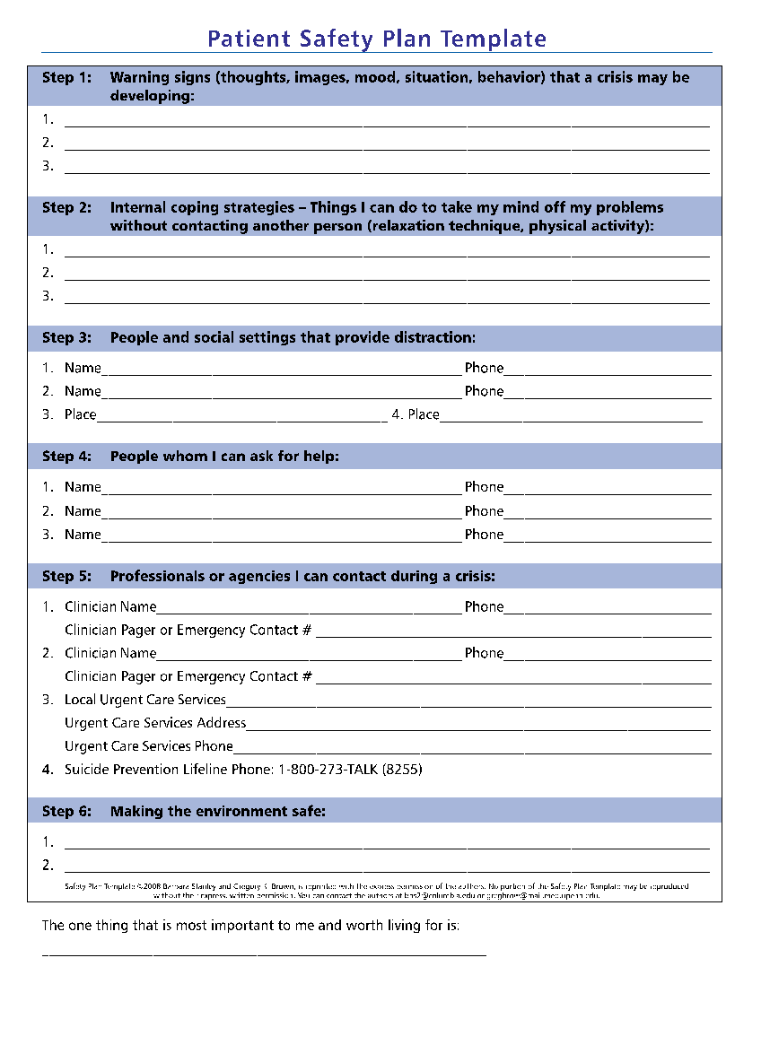
RESOURCE: SAFETY PLAN
Safety planning is a collaboration between the provider and the person at risk to develop a list of coping strategies and resources that can be used during a crisis.
The plan is brief, in the person’s own words, and
easy to read.
This is usually done in conjunction with a mental health provider. In an emergency it can be done with a friend, family member, someone in their support system…etc.
Safety planning can help remind someone about their support systems during a suicidal crisis.

Slide 39
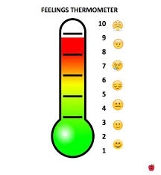
HOW A SAFETY PLAN HELPS KEEP THEIR THERMOMETER IN THE GREEN
Helps to develop:
Coping strategies that can help us get out of our head such as: take a walk, doing something physical, use a mindfulness app, find something to distract us, service someone else.
Social contacts that help provide distractions
People that can help: identify who is available in their life that can help during a crisis. Help ID emergency contacts and how to work with a provider using telehealth.
Using the thermometer helps the individual recognize where their emotions are on the thermometer and what strategies would be helpful.
(Stanley, B. (April 14, 2020). Treating Suicidal Patients During COVID-19: Best Practices and Telehealth. Suicide Prevention Resource Center Webinar. Retrieved April 14, 2020 from: www.sprc.org)

Slide 40
STEP # 5 FOLLOW UP
After your initial conversation with the person at risk and have connected them to the immediate support systems they need, make sure you follow up with them and help them stay connected.
Check in and see how they are doing. If they had to go to the hospital, ask how you can be helpful. Would they like visits, meals, phone calls? Don’t be afraid to ask if they have followed up on any supports you may have spoken about.
This step is important. This type of contact can continue to increase their feelings of connectedness and share your ongoing support.
Studies have shown a reduction in the number of deaths by suicide when following up was involved with high risk populations after they were discharged from acute care services.

Slide 41
Additional Thoughts
Let the individual know you are there to help and you will do your best to continue to support them during this time.
Acknowledge they what they told you for example, “Thank you for letting me know how you are feeling. I know this must have been hard for you but I am here to help.”
Follow college protocols. It is always good to ask about protocols before a crisis occurs.
Do not make any promises for example, “I’ll keep this between us."
Be patient and take care of yourself as well. Remember we are all in this together.
Setting boundaries is helpful even when it seems unhelpful. It’s okay to know your limits with regards to how much you can help.
Do not handle any of this on your own. Reach out for support.

Slide 43
PRACTICING SELF COMPASSION
Having self-compassion for oneself is really no different than having compassion for others.
First, to have compassion for others you must notice that they are suffering. Be aware when you are experiencing suffering.
Second, compassion for yourself involves feeling moved by your suffering so you can respond to your pain. When this occurs, you feel warmth, caring towards yourself.
Instead of mercilessly judging and criticizing yourself for various inadequacies or shortcomings, self-compassion means you are kind and understanding when confronted with personal failings – after all, whoever said you were supposed to be perfect.
(Neff, K. (January 2020). Self-compassion. Definition and Three Elements of Self-Compassion. Retrieved May 26, 2020 from: https://self-compassion.org/the-three-elements-of-self-compassion-2/)

Slide 44
LOCAL SUICIDE PREVENTION RESOURCES
Crisis Support Services of Alameda County
24/7 Crisis Line
988 or 1800-309-2131
Youth Textline
Text SAFE to 20121 (8a-12a Daily)
For Spanish: Text SEGURO to 20121 (5p – 9pm Tues-Fri)
Para Español: Textear SEGURO al 20121 (5 pm - 9 pm martes - viernes)

Slide 45
NATIONAL SUICIDE PREVENTION RESOURCES
988 Suicide & Crisis Lifeline
Crisis Line 988 (24-Hours)
Crisis Textline
Text BRAVE to 741-741 (24-Hours)
Trans Lifeline
1-877-565-8860
Run by and for transgender communities. Available 7am-1am PST / 9am-3am CST / 10am-4am EST.
The Trevor Project for LGBTQ+ Youth
Crisis Line 1-866-488-7386 (24-Hours)

Slide 47
Questions?

Slide 48
CONTACT INFORMATION
Mercedes Coleman
Dept. Director, Community Education Program
510-420-2473
mcoleman@crisissupport.org
Cristina Rita
Program Manager, Community Trainings
510-557-1623
crita@crisissupport.org

