Slide 1
Reading and Annotating with Hypothesis in the ZTC Classroom
Autumn Ottenad (Hypothesis), Kat King, Maureen O’Herin, Katie Eagan
Notes:
Maureen
Katie
tips and tricks for using Hypothesis with database articles and ebooks from the catalog

Slide 2
Hypothesis Intro
Autumn Ottenad, Hypothesis Liaison!
https://bit.ly/LasPositasOER2021
Notes:
Autumn https://hypothesis.instructure.com/enroll/KHKKWH
Basics of Hypothesis
How to use Hypothesis with LibreText
Autumn
Basics of Hypothesis
How to use Hypothesis with LibreText
Some creative/more advanced uses of Hypothesis creative/more advanced uses of Hypothesis

Slide 3
Build community and digital literacy w/ Hypothesis
Step 1: Instructor provides articles from right and left-leaning sources for small group annotation
Kat King, English
Step 2: Students find examples and analyze rhetorical strategies in right and left-leaning sources
#ClimateCrisis or #ClimateHoax?

Slide 4
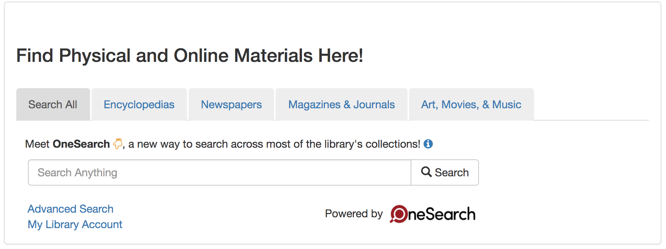
Students build independence
Step 3: Students research using (free!) Library Databases and select a (free) book to read to learn more
Kat King, English

Slide 5
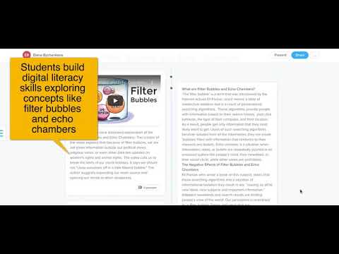
Students produce a digital essay
Step 4: Students pull from annotations to build a digital research essay
Student Essay: Climate Change (shared with permission!)
Kat King, English

Slide 6
Jane Eyre on Project Gutenberg--Maureen O’Herin
Deeper dive into using Hypothesis to read a longer work, in this case a novel
Find your long text + check for Hypothesis compatibility
Accessing a text in Project Gutenberg
Creating an assignment in Canvas
Breaking the reading into sections
Assign a new focus or scaffold the focus of annotations as students read
Use Tags to help students focus on their final project for the text
Bring in text and media that students can link to the reading and discuss
View the reading/annotating along the way
support folks who fall behind
Model and encourage good annotations early and throughout the reading
Students can access sections of the long work with Tags, so their final project comes together with ease and depth.

Slide 7
Using Hypothesis with Library Database Materials--Katie Eagan
Some caveats:
balancing the potential of providing online materials at no cost to students with fair use laws; think about the following:
For database articles, students are able to access those online anyway; Hypothesis just provides a vehicle to read them.
For books that have limited digital copies, use an excerpt. The Columbia U Copyright Advisory Office asks the following:
Does the excerpt “fulfill a demonstrated legitimate purpose in the course curriculum”? Is it “narrowly tailored to achieve that purpose”?
Does the excerpt constitute a small portion of the work, and is it not “readily available for digital academic use at a reasonable price”?
Is it only accessible to students enrolled in a specific course and term?
Do you remind students of copyright limitations so that the article won’t be distributed to others?
(https://www.usg.edu/copyright/the_fair_use_exception)

Slide 8
Caveats, cont.
Not every database or article will work well with Hypothesis
If using the permalink, it has to be hosted at a public URL;
When downloading a PDF is possible, that is one’s best bet; you would then upload it into Canvas Files;
Some PDF’s, however, are in columns, which Hypothesis has trouble with
PDF’s need selectable digital text, and some PDF’s are poorly OCR’ed
Plan out in advance and ask Hypothesis for help if necessary

Slide 9
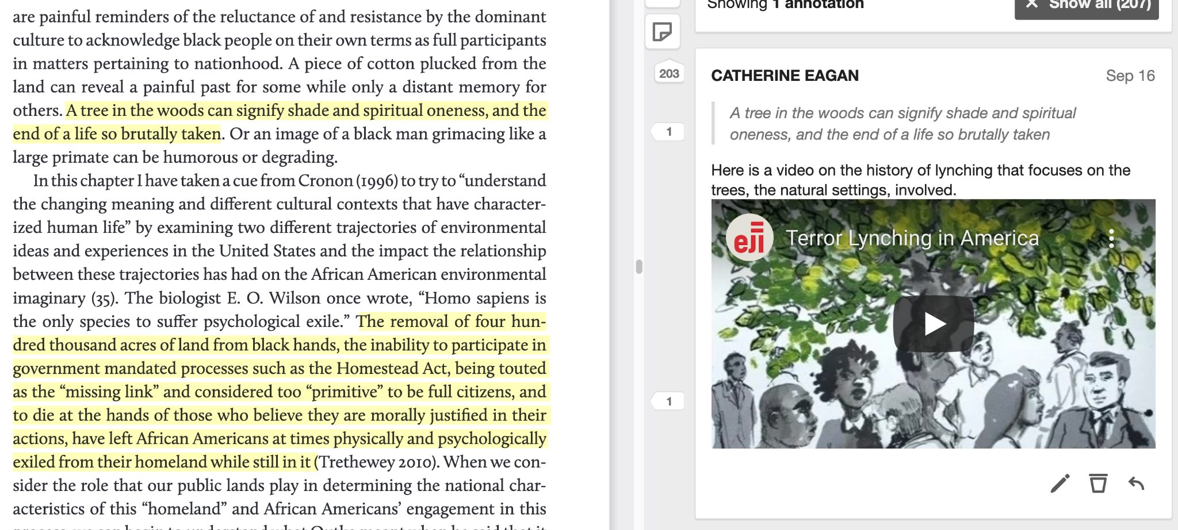
Ebook in One Search:
Carolyn Finney, chapter from Black Faces, White Spaces

Slide 10
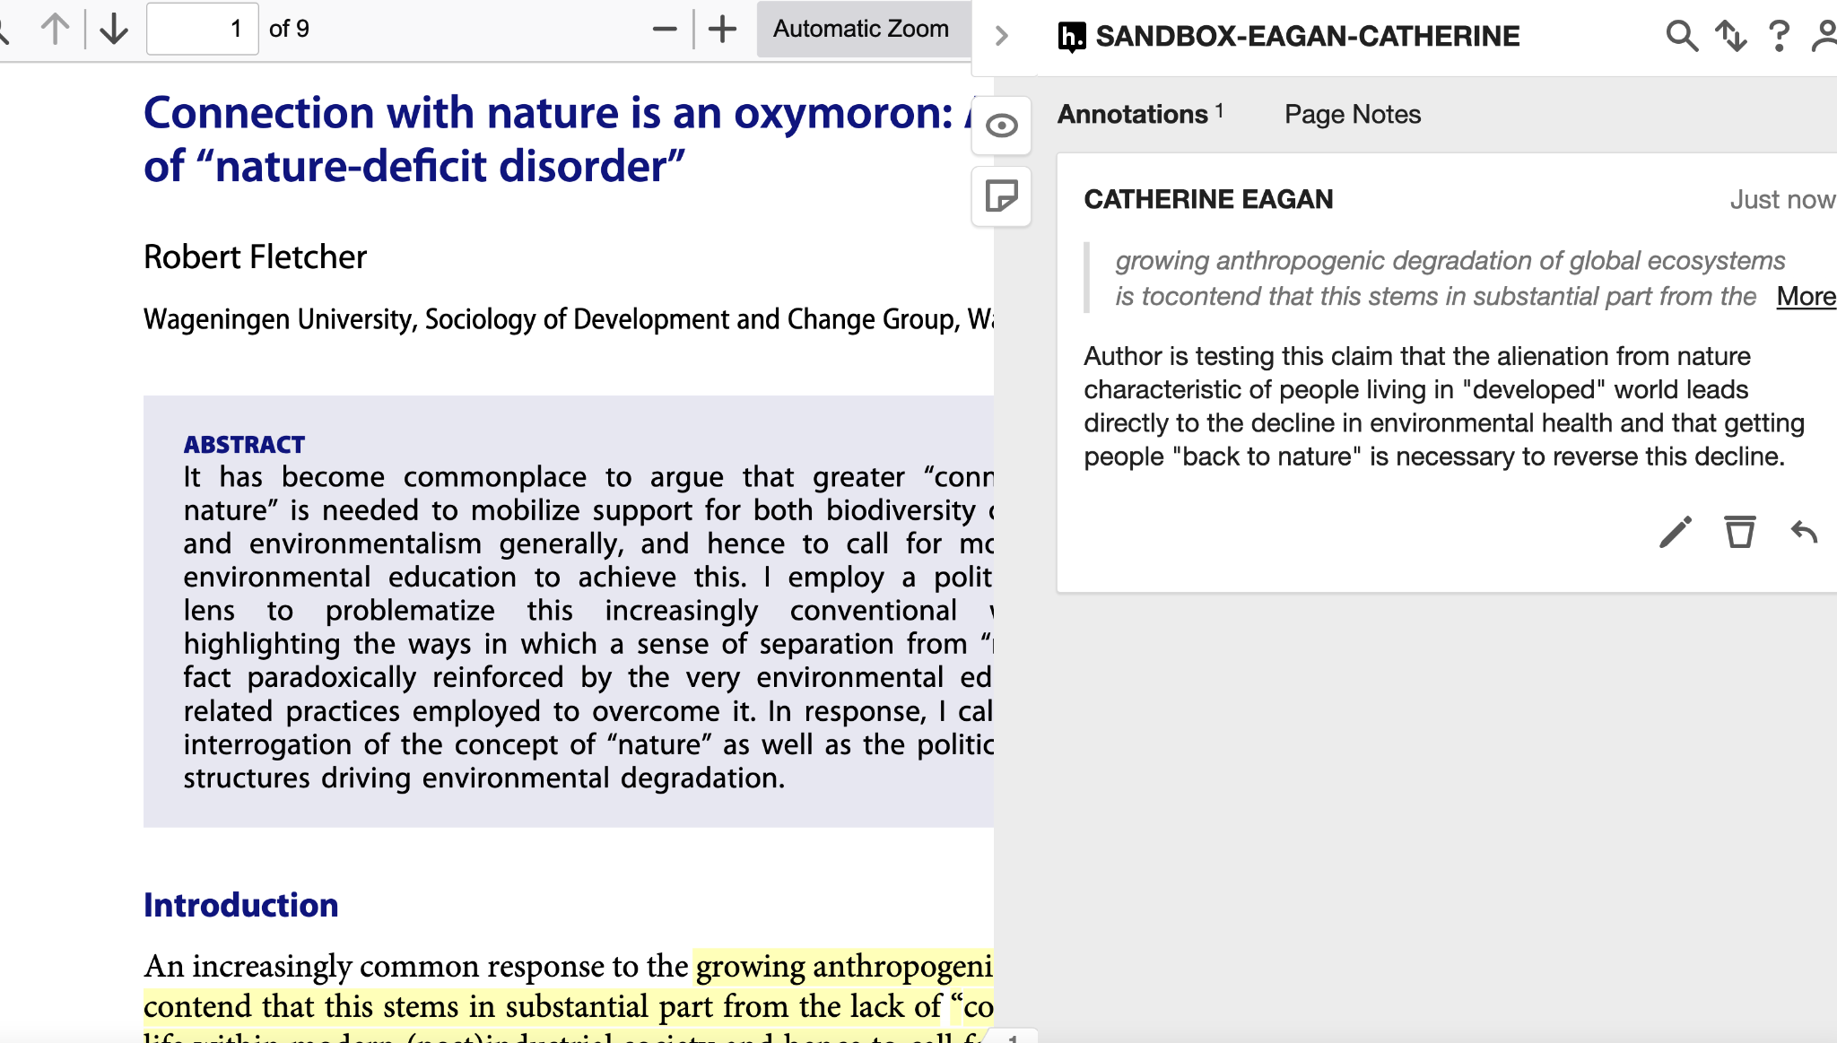
Psych. and Behavioral Sciences database:

Slide 11
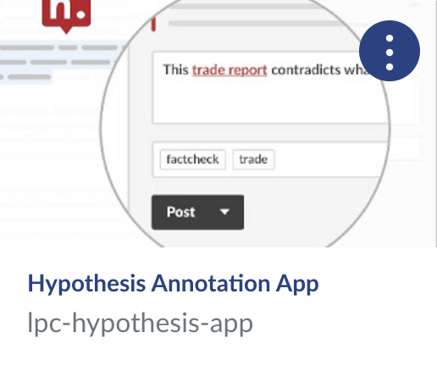
Questions?
Visit the Hypothesis Canvas shell!
Tutorials
TLC workshops
Webinars
Sample Assignments
Contact Autumn Ottenad to set up a 1:1 appointment: https://meetings.hubspot.com/autumn-ottenad/instructor-one-on-one

Slide 12
Please fill out the survey!
https://docs.google.com/forms/d/e/1FAIpQLSd4CXo6RK0NQ1-17H7j6Y7XNpNf-oBRi7E8scS_evts6qHI-Q/viewform

