Slide 1
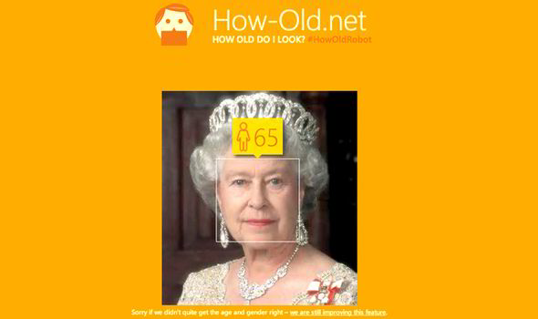
Facial Recognition
Paul Hrycewicz
Computer Science
October 20, 2020

Slide 2
Conclusion
There is no magic, nor true understanding, by machines or software algorithms.
There may be the appearance of understanding, or intelligence, by advanced technology or by sufficiently clever algorithms.
Two parts to image recognition:
  (1) Finding and identifying the image in a picture
  (2) Using the image’s features in a predictive model

Slide 3
Agenda
Predictive modeling overview
Image Representation
Feature Recognition
Convolutional Neural Networks
Facial Recognition
Accuracy
Face Databases

Slide 4
Predictive Modeling
A predictive model describes a set of data in such a way that it can predict the values of one or more parameters.
All modeling is based on statistical analysis. There is no “magic” involved. Modeling simply uses the patterns that exist in data to develop probabilities of events.
It would be extraordinarily time-consuming (“analytically intractable”) for a human to develop an accurate predictive model.
Numerous modeling software packages exist at reasonable cost from vendors like Google, SAS, Amazon, and Microsoft.

Slide 5
An Example of a Predictive Model
Large trucking company has 2,000 trucks and 1,600 drivers.
The driver churn rate is 70% - 7 out of 10 drivers leave the company each year.
Training a new driver takes 3 months and costs the company $14,000.
This represents a $15.7M annual expense for the company.
Can we use a predictive model to predict which drivers are most likely to churn, so that the company can take proactive steps to prevent?
If we can reduce the churn rate by 10%, that represents a $1.5M annual savings for the company.

Slide 6
Data for the Model
Employee age
Employee gender
Employee home location
Years driving
Years with company
Number of traffic tickets
Family size
Favorite brand of blue jeans

Slide 7
Sample Data
Name Gender Home zip Years exp Years empl Tickets Fam size Blue Jeans Did they
churn?
Joe M 95083 4 2 0 2 Levi’s No
Sam M 15097 2 1 3 4 Wrang Yes
Mary F 32807 3 3 1 2 Levi’s No
Kim F 10056 13 2 2 0 Wrang Yes
Teddy M 75234 8 5 3 8 OldN Yes
Sally F 90432 1 0 7 2 Gap No
Davey M 60604 4 2 3 4 Levi’s Yes

Slide 8
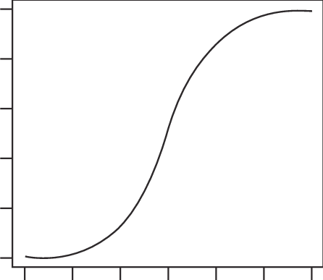
Logistic Regression Model
This is only ONE method out of MANY that techniques for modeling.
LR returns the probability of an event happening – a number between 0 (low probability) and 1 (high probability)
Expressed as a probability curve, which is closely related to the bell curve
1
Probability of an
employee
churning
0
Employee data

Slide 9
Building and Using the Model
1. Supervised Learning -
with a training set
2. Scoring – determine the answer
for a particular piece of data
Age | Gender | Home zip | Tickets | … | Churn
37 | M | 95053 | 2 |  | N
23 | F | 60603 | 7 |  | Y
42 | D | 32788 | 0 |  | N
Data on employee
. . .
Develop
Model
Model
Churn?
.832754

Slide 10
Image Recognition

Slide 11
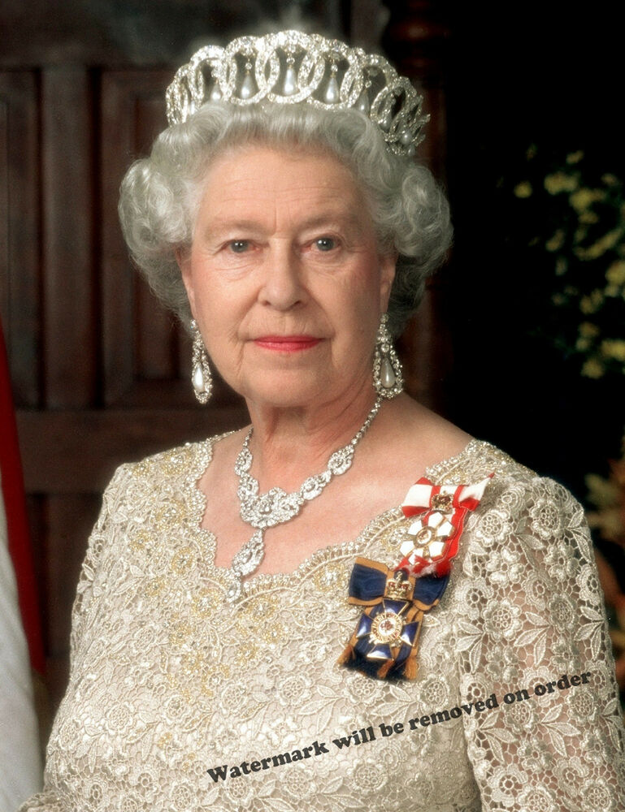
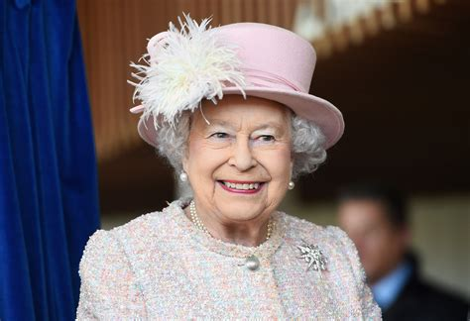
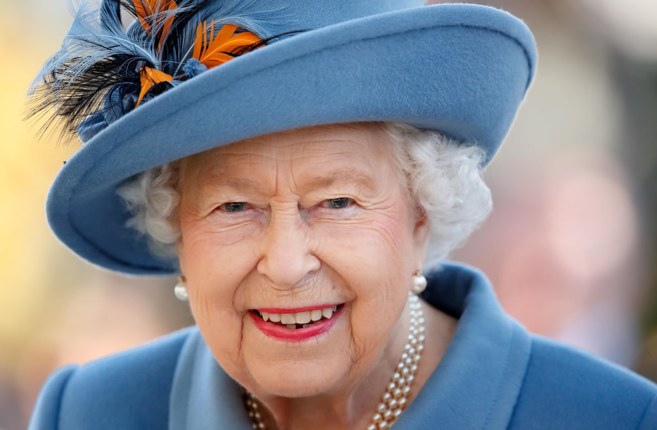
Images of Queen Elizabeth
2002 (age 76)
2020 (age 94)
2020 (age 94)

Slide 12
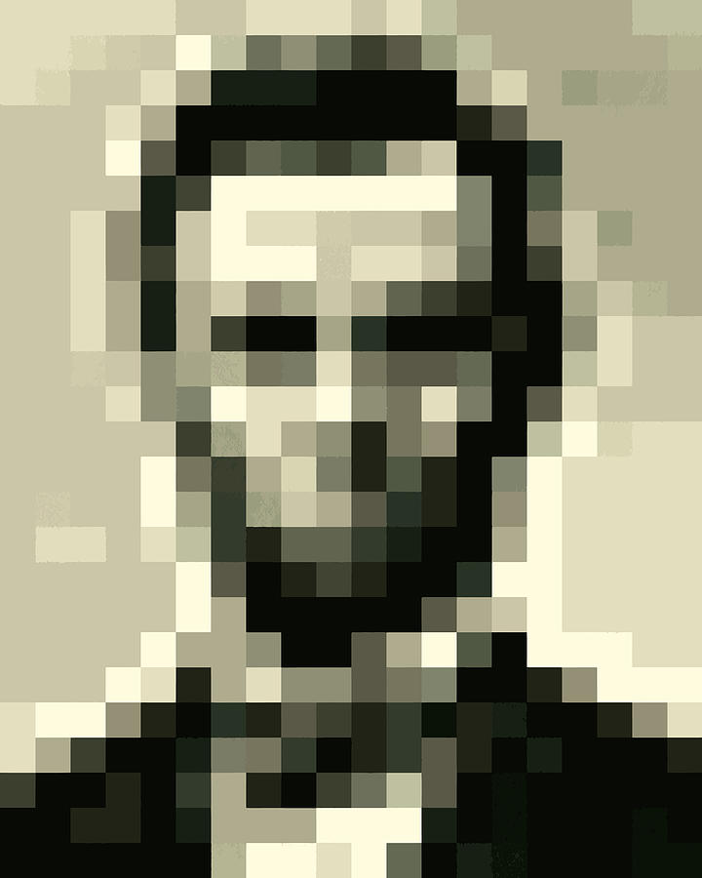

Image Recognition
An image is recognizable even if it contains only a small amount of data.
20x25 = 500 bytes
22x21x3 = 1,386 bytes
A good resolution color picture on a web page is typically about 250K (but 25K when compressed, typically at 10:1). An HDTV frame is 18.6 MB.
If a human can recognize the image, an algorithm should be able to as well.

Slide 13
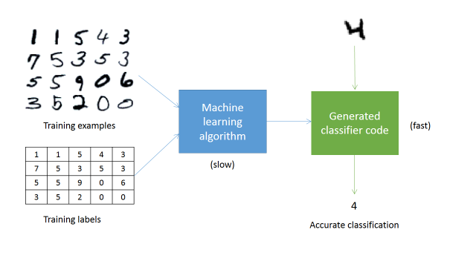
Image Recognition – Digit Classifier
Training Set
image
Model
1 | 1 | 5 | 4 | 3
7 | 5 | 3 | 5 | 3
5 | 5 | 9 | 0 | 6
3 | 5 | 2 | 0 | 0
2
numeric
value
But – what is ?? It’s not a variable with a numeric value
like an age or a zip code.

Slide 14
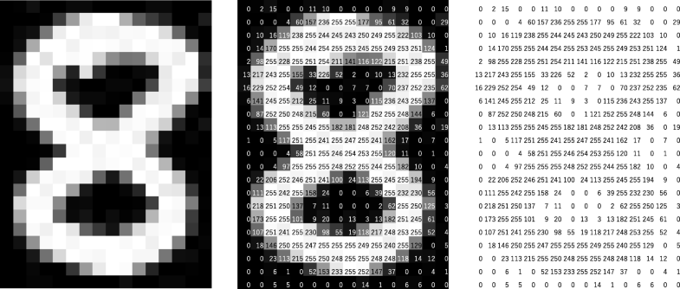
Image Representation
A picture is a set of pixels, each with a numeric value.
lighter = higher values
darker = lower values

Slide 15
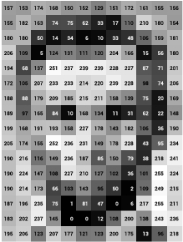
Image Representation

Slide 16
Looking for an “X”
activation map
0
1
1
0
1
0
0
1
1
0
looking
for \
1
0
0
1
0
1
0
1
1
0
\ filter
picture of ‘X’
pixels
remember
low = dark
high = light
0
1
looking
for /
1
0
/ filter
A convolution with two
activation maps

Slide 17
Do We See an “X”?
Brute Force Approach
Given the activation maps,
we can determine if an “X” is present or not.
Can use “brute force” approach:
IF the pattern in the “\” map is
three 0’s in a diagonal
from top left to bottom right
AND
three 0’s in a diagonal
from top right to bottom left
THEN it’s an “X”
activation maps

Slide 18
Do We See an “X”?
Supervised Learning Approach.
. . .
flattened
activation
map
Model
activation maps

Slide 19
A Better Approach…Feature Detection
A feature is a part of an image that we consider significant.
Low-level features include edges and curves.
Higher-level features might be wheels, wings, or eyes.
We use a convolutional filter to detect features.
A filter enables the computer to “see.”
A filter transforms a set of pixels (numbers) into something that an algorithm can interpret.
Example: A filter to detect a vertical edge. It “looks” for a dark line on the left of a light line.
-1 | 0 | 1
-1 | 0 | 1
-1 | 0 | 1

Slide 20
Detecting Features - \
Picture
Filter
Convolution
1 | 1 | 1 | 1 | 1 | 1
1 | 1 | 0 | 1 | 1 | 1
1 | 1 | 0 | 0 | 1 | 1
1 | 1 | 1 | 0 | 0 | 1
1 | 1 | 1 | 1 | 0 | 0
1 | 1 | 1 | 1 | 1 | 0
1 | 0 | 0
0 | 1 | 0
0 | 0 | 1
filter to look
for \
noise reduction:
ignore anything
>0? >1?
do we care about dark->light
vs light->dark?
If we do, we can adjust the filter.
If we don’t, we can use one filter and take
the absolute value
remember
low = dark
high = light

Slide 21
Detecting Features - /
Picture
Filter
Convolution
1 | 1 | 1 | 1 | 1 | 1
1 | 1 | 0 | 1 | 1 | 1
1 | 1 | 0 | 0 | 1 | 1
1 | 1 | 1 | 0 | 0 | 1
1 | 1 | 1 | 1 | 0 | 0
1 | 1 | 1 | 1 | 1 | 0
0 | 0 | 1
0 | 1 | 0
1 | 0 | 0
filter to look
for /
The filter will ignore random noise.
Non-random noise may present a problem.

Slide 22
Detecting Features - Edges
Picture
Filter
Convolution
0 | 0 | 0 | 1 | 1 | 1
0 | 0 | 0 | 1 | 1 | 1
0 | 0 | 0 | 1 | 1 | 1
0 | 0 | 0 | 1 | 1 | 1
0 | 0 | 0 | 0 | 0 | 0
0 | 0 | 0 | 0 | 0 | 0
-1 | 0 | 1
-1 | 0 | 1
-1 | 0 | 1
noise reduction:
ignore anything
< 3?
filter to look for
dark->light vertical
edge

Slide 23
Curve filter
So…
Why not design a filter for a face?
We don’t know where in the image the face is.
We don’t know how large the face is.
All faces are different.
We’d need many filters, and each would be huge.
There’s a big difference between recognizing something as a face in an image, and identifying that face as belonging to a specific person.
Better to start with the basic features found in an image, and then determine if they build into a face.
0 | 0 | 0 | 0 | 1 | 0
0 | 0 | 0 | 1 | 0 | 0
0 | 0 | 1 | 0 | 0 | 0
0 | 0 | 1 | 0 | 0 | 0
0 | 0 | 1 | 0 | 0 | 0
0 | 0 | 0 | 1 | 0 | 0

Slide 24
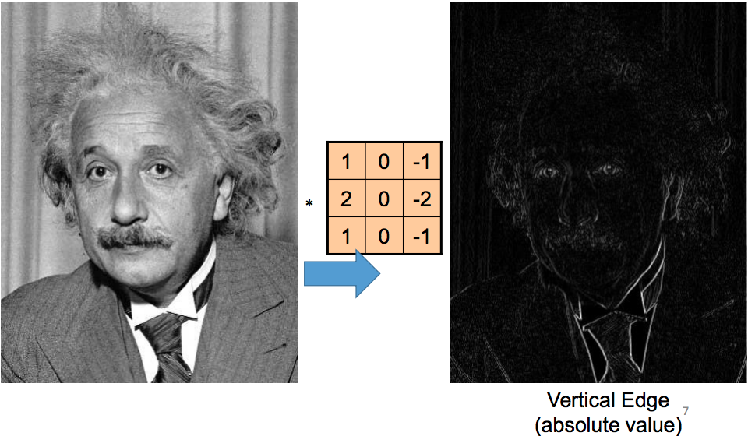
Edge Detection on an entire image
Sharpening filter
Easier to discern features from an edge

Slide 25

Pooling
We can take the convolution and convolute it further to condense it.
filters looking
for arcs
filter looking
for circle

Slide 26
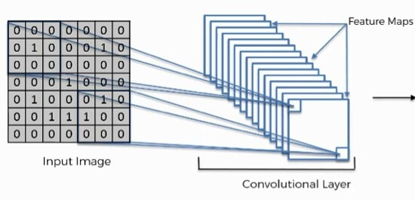
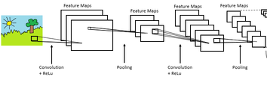
Feature Maps
filters looking
for arcs
filters looking
for horizontal
half-ellipses
filters looking
for vertical
half-ellipses
In this way, we get a condensed representation of
the features present in an image.
filters looking
for horizontal
lines
. . .

Slide 27
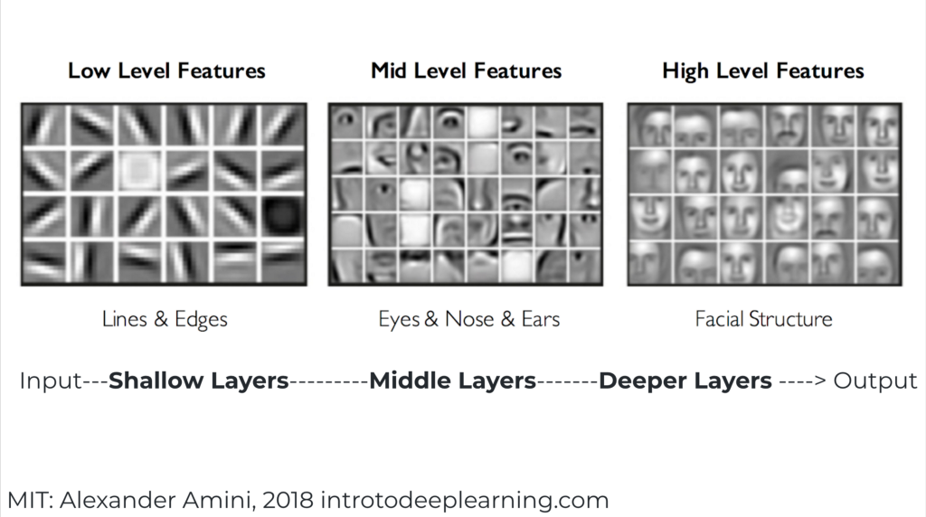
Convolutional Layering

Slide 28
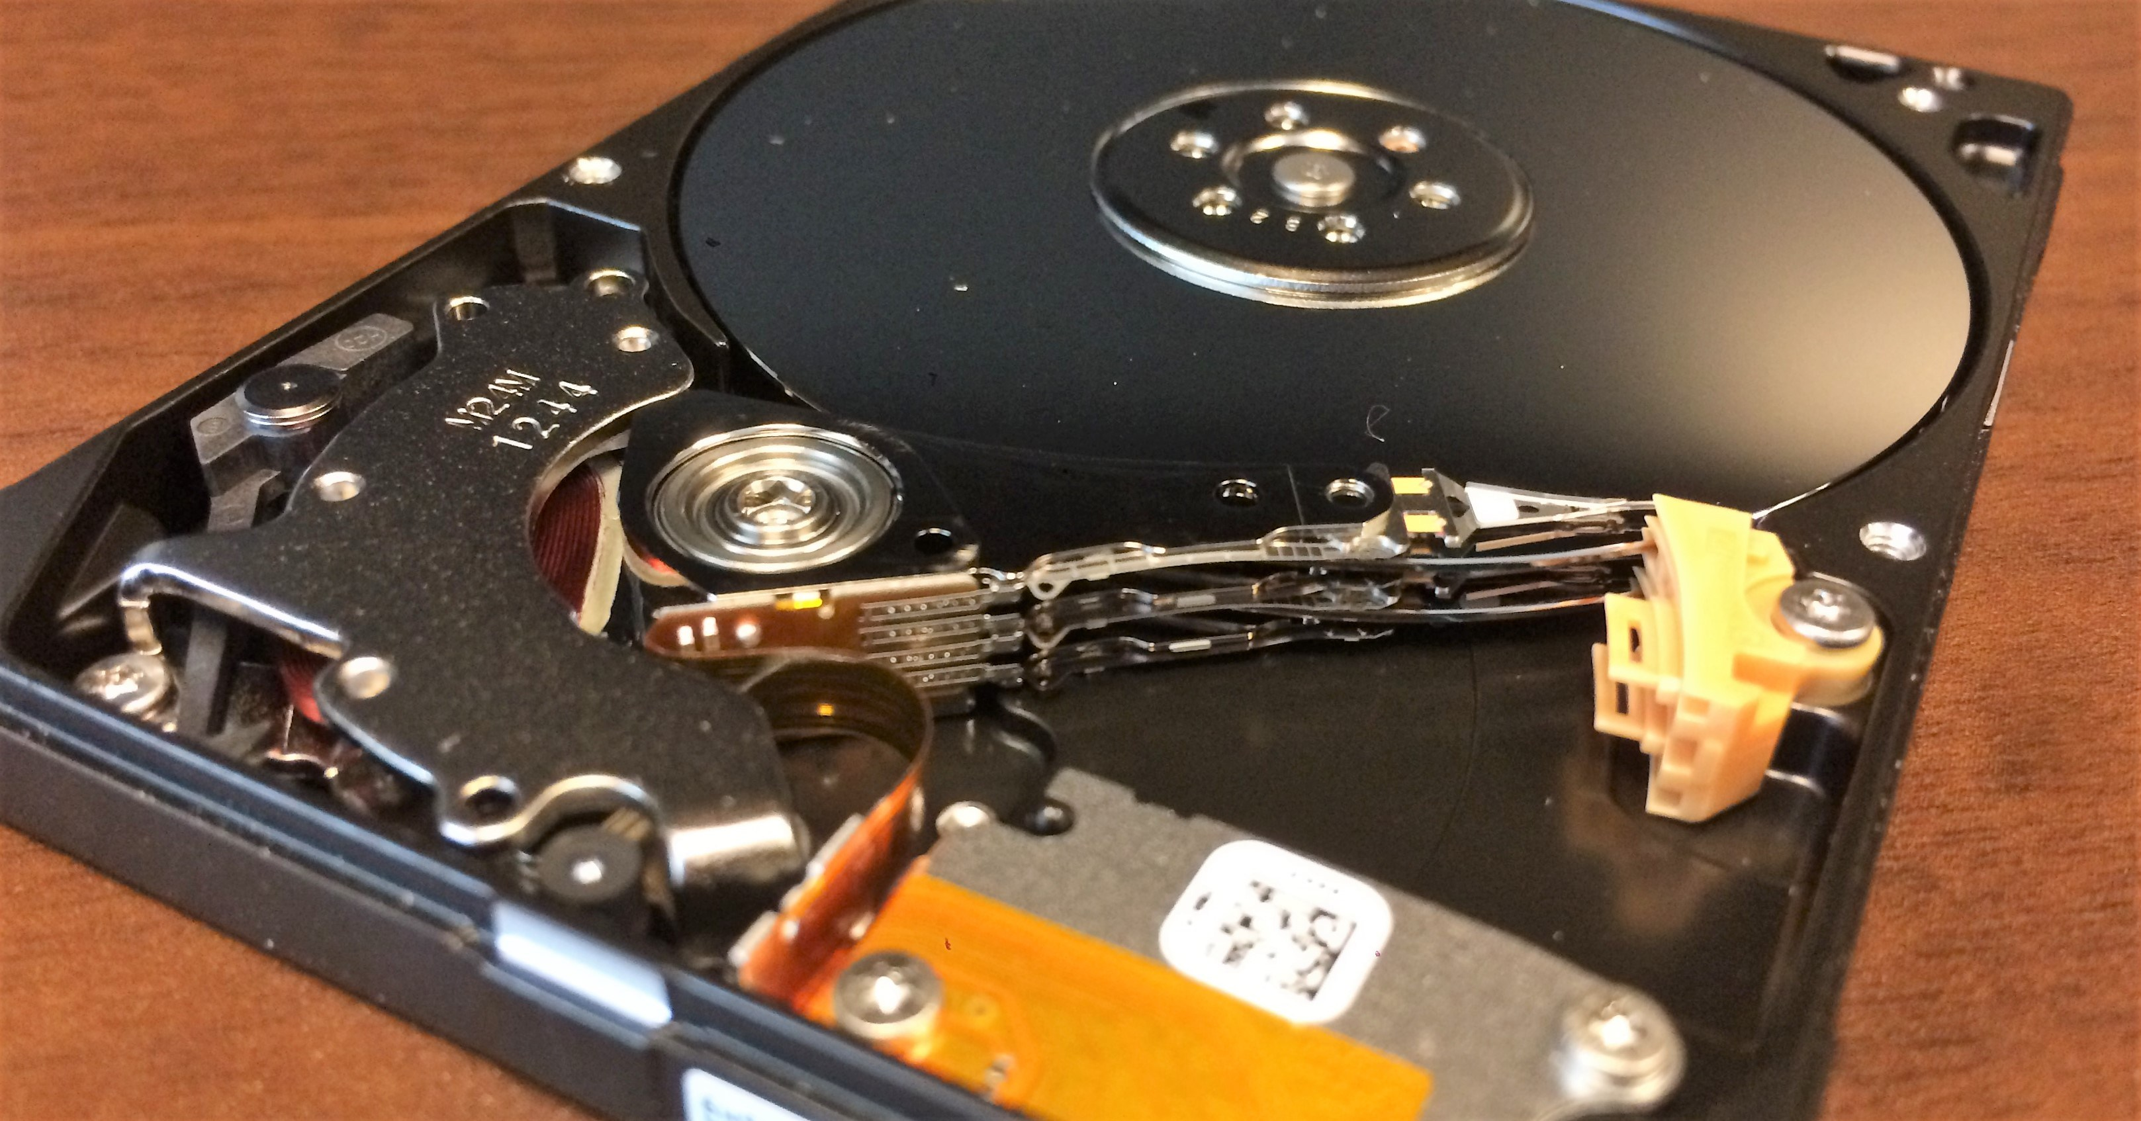
Commercial uses of general-purpose image recognition systems
Microsoft, Google, and Amazon offer services which learn how to recognize objects, based on images and labels which you provide.

Slide 29
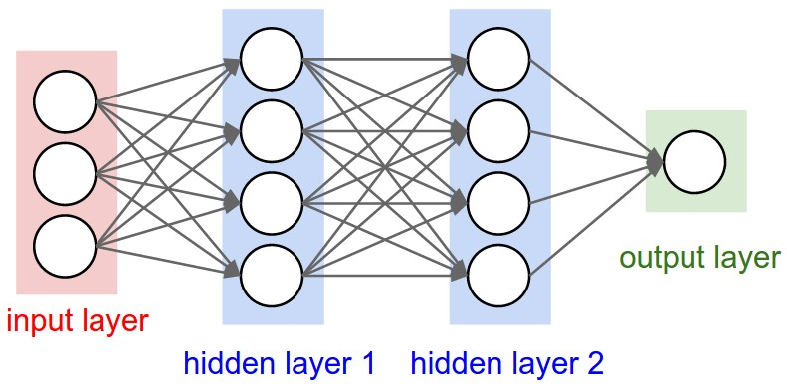
Artificial Neural Networks (ANNs)
The NN transforms a set of inputs into an output.
This is what our brains do.
What was the name of the old movie with Jack Nicholson about a nurse and a hospital?

Slide 30
Using a NN for the Digit Classifier:
Step 1. Training the “fully connected” layer (the ANN)
NN
Model
Training
Flattened
NN input
layer
Activation maps

Slide 31
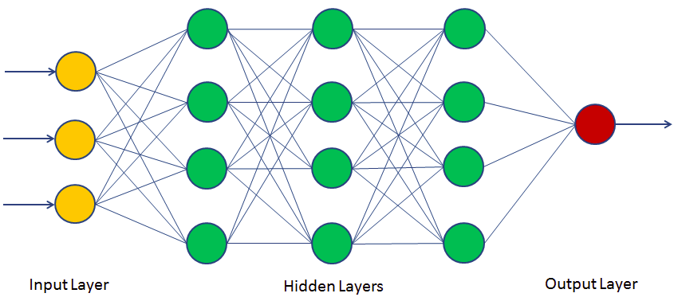
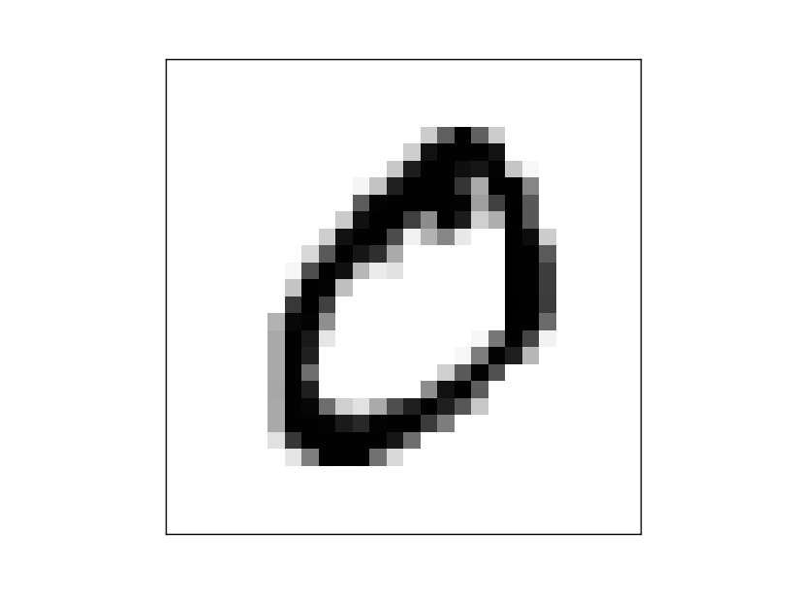
Using a NN for the Digit Classifier:
Step 2. Scoring
.99765
probability it’s a zero
Image
Convolutions
Flattening
Model
Result
This is called a convolutional neural network (CNN) – a set of convolving layers which develop inputs into a neural network.
The fundamental theory behind a CNN is that pixels which are close together are more likely to be related than pixels far away from each other.
This is how our brain recognizes what is seen by the eyes.

Slide 32

Facial Recognition
Result
Gender
Age
Facial Feature Map
Image
Convolutions
Flattening
Model
Queen Elizabeth II
Buckingham Palace,
Westminster, London, SW1A 1AA
b. 1926, Mayfair, London
Database
lookup

Slide 33
Facial Feature Map
"faceId": "5af35e84-ec20-4897-9795-8b3d4512a1f9",
"faceRectangle": {"width": 60, "height": 60, "left": 276, "top": 43},
"faceLandmarks":
{"pupilLeft": {"x": "295.1","y": "56.8"},
"pupilRight": {"x": "317.9","y": "59.6"},
"noseTip": {"x": "311.6","y": "74.7"},
"mouthLeft": {"x": "291.0","y": "86.3"},
"mouthRight": {"x": "311.6","y": "88.6"},
"eyebrowLeftOuter": {"x": "281.6","y": "50.1"}

Slide 34
How does commercial-grade FR work?
Take stills from video camera feed
Find faces
Develop features for each face:
gender, age, ethnicity, measurements
Search facial image database
The actual algorithms used by commercial companies’ services are proprietary
Companies do not supply the facial image database – the user does

Slide 35
Accuracy
Generally measured in 9’s – 99%, 99.9%, 99.99%, etc.
There is an industry accuracy benchmark: The NIST FRVT (National Institute of Standards and technology Facial Recognition Vendor Test).
False Positive – mistakenly identifies a face as belonging to a person
False Negative – fails to recognize a face when it exists in the database
99.99% accuracy means that 9,999 out of 10,000 faces are recognized without error – therefore,
1 out of 10,000 is not and may be returned as a false positive or false negative.
Commercial facial recognition services such as Amazon Rekognition and Microsoft CNTK are careful not to advertise any particular application for their technologies, nor guarantee any accuracies. It is generally thought that the accuracy is as high as 99.97% for these systems, given ideal conditions.
In 2019, SFO had an average of 157,735 passengers per day. 99.97% accuracy means that there could be as many as 47 incorrectly identified passengers per day.
When field-quality photos are used, such as those obtained from cameras scanning wide areas at airports, the error rate rose to as high as 9.3%. Subjects may not be looking directly into the camera, and may be partially obscured by shadows or other objects.
Error rates increased as much as 10x when mugshots 10 years old were used.

Slide 36
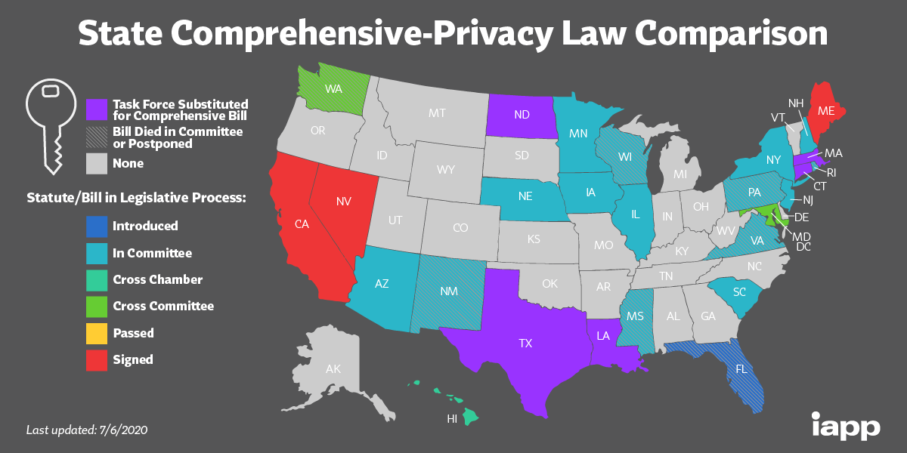
Facial Image Databases
Most images available on the web have not been privacy-protected.
Some image databases are restricted; states’ DL photos, for example.
ICE, DOJ, and FBI are already using states’ drivers licenses photos and mugshots.
Inter-agency agreements allow law enforcement to share data.
Only some data – PII and HIPAA – are federally protected.
Some states have a Consumer Privacy Act (modeled after the CCPA) which allows you to opt out of data collection.
Of course, people voluntarily submit data when the post to social media platforms.
San Francisco has banned the use of facial recognition by its agencies.

Slide 37
Facial Image Databases
Amazon, Microsoft, and Google do not maintain facial image databases. They require you to maintain your own.
Clearview AI is an example of a company that markets both a facial recognition service and an underlying database of faces and identifying information. Its database is advertised to contain 3BN faces.

Slide 38
Thank You!
Recap:
Predictive models are statistical processes which “learn” how to predict results from training data.
Images are stored as collections of pixels, which may be scanned and analyzed by repetitive simple processes.
A convolutional neural network is a combination of image processing and a trained neural network model.
CNNs for facial recognition may have high accuracy, but accuracy decreases when ideal conditions are not met.
Services offered by vendors like Amazon and Microsoft include the recognition algorithms, but not the underlying database. That must be supplied by the user.

