Slide 1

Your Knowledge Matters: Become a Community Education Instructor
Guest:
Sophie Rheinheimer
10/23/25
Flex Day 2025
Megan Garcia, Community Education Coordinator

Slide 2
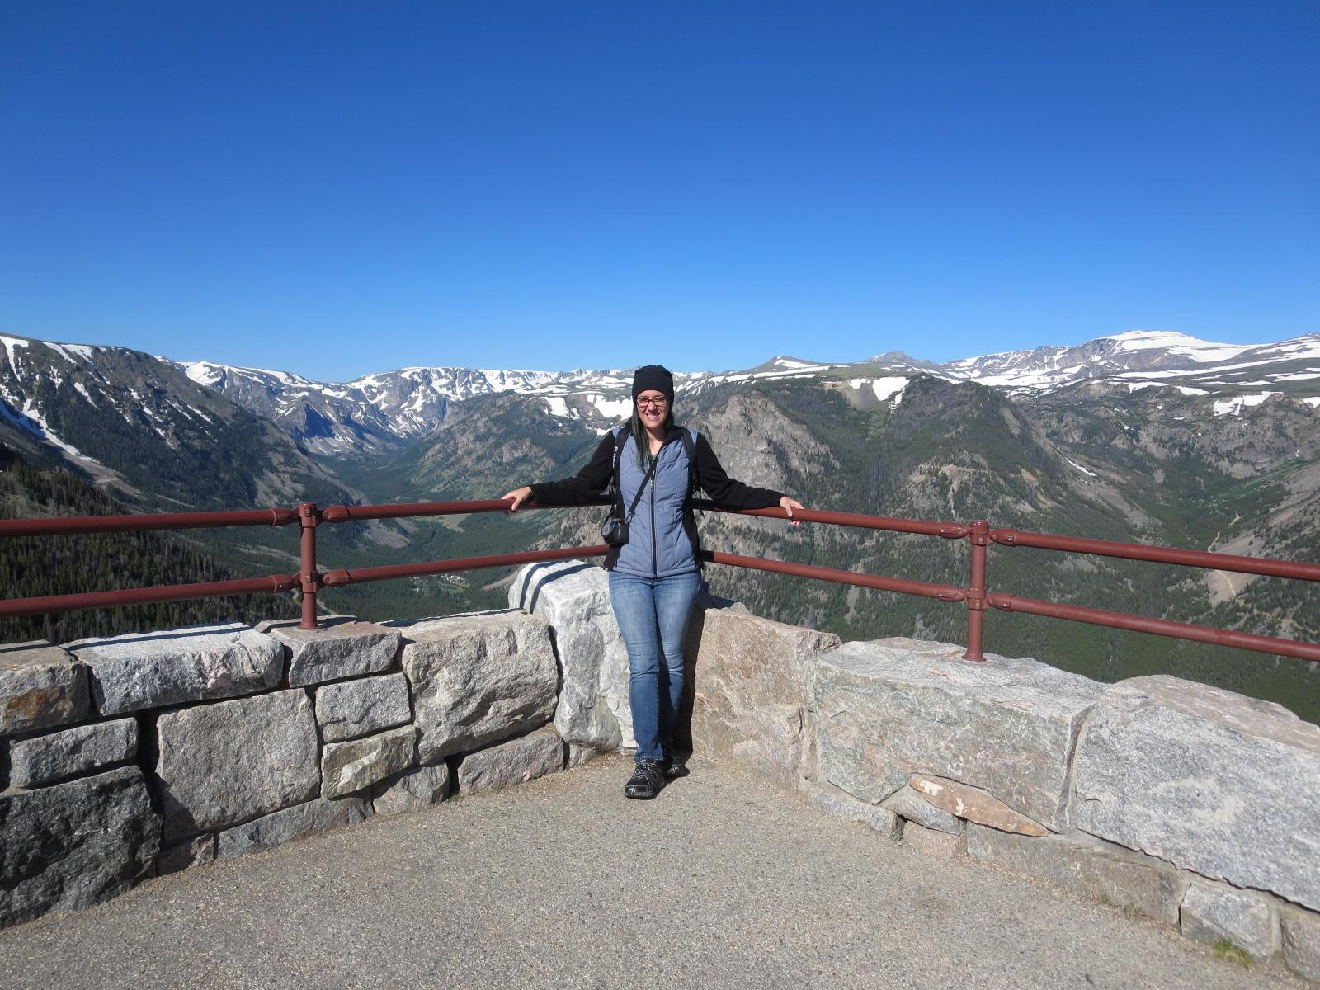
Hi!
I’m Megan Garcia
Community Education Coordinator
LPC and SFSU Alum
Started in English Department (adjunct, Instructional Assistant, RAW Center)
Community Education Coordinator Oct. 2023
About Me

Slide 3
The Fact Files: Com Ed
Fact or Fiction: Community Education offers “not-for-college-credit” courses.
Fact or Fiction: We focus on personal enrichment courses, such as art, fitness, languages, etc.
Fact or Fiction: Community Education is a fee-based program and does not receive financial support from the college.
Fact or Fiction: We are considered an adult school.
Fact or Fiction: You need teaching experience and at least a BA to teach with us.
Fact or Fiction: We have our own registration system and platform.

Slide 4
Who are our students, and what do we offer?
10-55+
Adults: Career Change, upskilling, personal enrichment
Non-Traditional Students
Job Training
Summer Camps, both closed and open to the public
3rd Party Funding
Languages
Art
Professional Enrichment
Upskilling
Contract Ed
Travel
Wellness and Fitness

Slide 5
Com Ed Pathways
Credit
Noncredit
Certificate Program
Vacuum Technology: Com Ed
Required Training for New Hires
Contract Education
Pursue Other Opportunities

Slide 6
Com Ed Pathways
Youth Summer Camp
Dual Enrollment
Apply w/ LPC
Pursue Certificate
Pursue AA/AS/AA-T
Pursue Certificate
Pursue AA/AS/AA-T

Slide 7
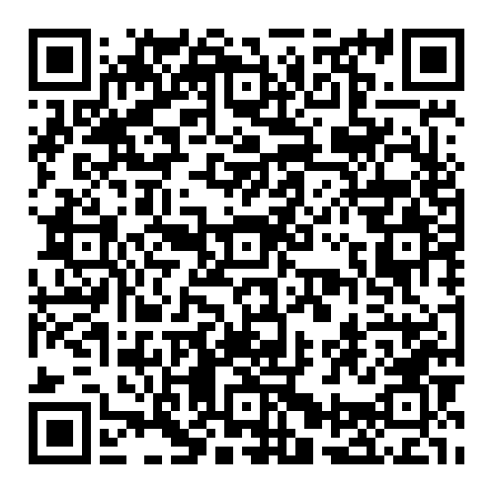
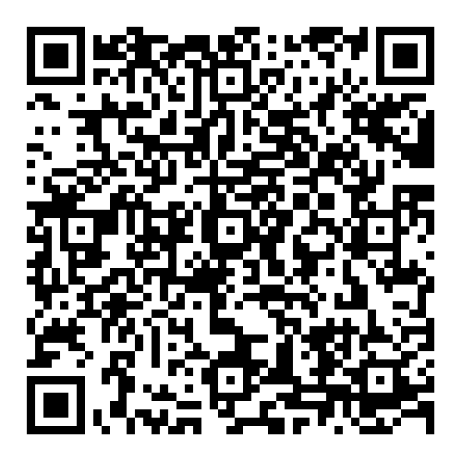
Steps for proposing a course
Submit a Course Request
Teach your class!
Course requests are collected twice a year:
Fall
Spring/Summer
While we send a print catalog out to our community, our instructors are responsible for promoting their class as well.
Review the Instructor Handbook
Submit a Course Proposal

Slide 8
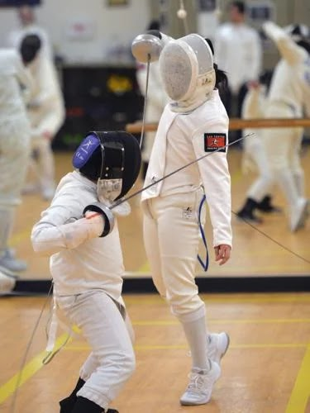
Sophie Rheinheimer
Com Ed Instructor
Sophie Rheinheimer is the founder and senior coach of the Las Positas Fencing Center. Sophie has fenced competitively at both the national and international levels. She won a bronze medal at the 1998 Nike World Master Games and was a member of the USA team competing at the 1999 and 2000 Veteran's World Fencing Championships in Siofok and Godollo, Hungary. Sophie is also a founding faculty member at LPC, where she began teaching PE in 1975. She began teaching fencing classes at LPC in the early 1980s and founded the Fencing Center in 2002.

Slide 9
Thank, Pair, Share
HOW? How might Com Ed be leveraged in a way that benefits my department, and/or what am I good at? What skills, interests, or hobbies may be of interest to our community?
What? List a few potential classes (2-3)
WHY? Choose one to two that you listed above, and write a sentence or two explaining your WHY.
Community Education may be a place for us to test out our Vacuum Technology course. This is an in-demand skill that has the potential to become a non credit or for-credit class. I myself have been practicing Muy Tai for over 10 years and have been thinking of teaching it.
Vacuum Technology
Muay Thai for Beginners
Self-Defense for Teens
There is a growing demand for expertise in vacuum technology training since this expertise is needed in a variety of industries.

Slide 10
What to look forward to!
Spring/Summer 2026
First Aid/CPR Training
CPR (BLS)/ First Aid
Babysitter CPR/ First
Aid
Sports CPR/First Aid
Career Readiness
Strategic Job Search in the Modern Market
Building a Professional Identity That Opens Doors
Using AI and Technology to Get Ahead
Improv. w/ Faith Alpher
Improv Your Confidence: From Stage to Everyday Life
Language Classes
Beginning French Language and Culture 1
French for Travelers
Korean Language and Culture

Slide 11

Q & A

Slide 12

Thank you!

