Slide 1


Fostering a Sense of Belonging for All Students
Caring Campus at LPC
Flex Day, October 23, 2025

Slide 2

Agenda
Introductions
Overview of Caring Campus & services
Warm up in pairs
Small group work
Sharing
Wrap Up

Slide 3
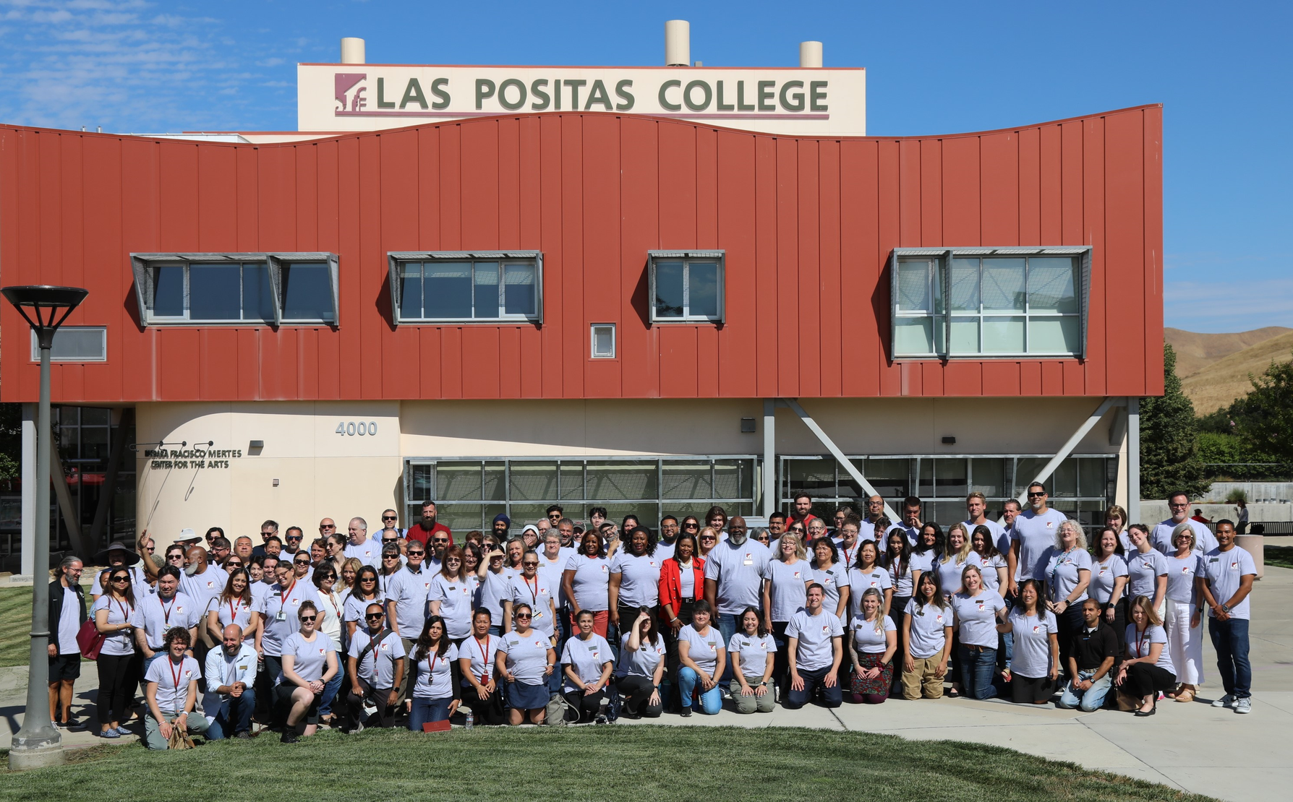
What is Caring Campus?
Caring Campus is a program that encourages connection with students by faculty, classified professionals, and administrators
Studies show that when students feel a sense of belonging, they persist at higher rates. For this reason, LPC has adopted three behavior commitments.

Slide 4
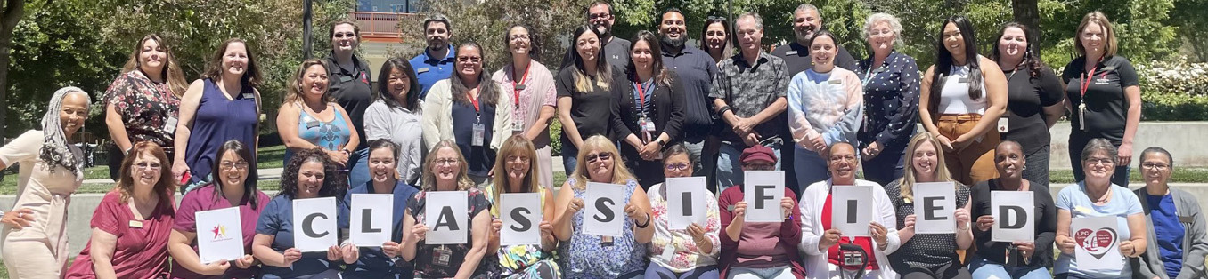
Behavioral Committments
03.

Slide 5
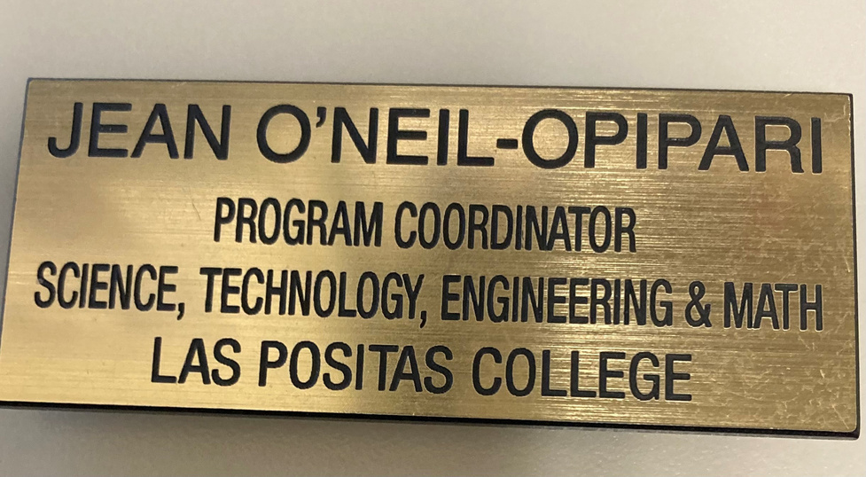


LPC’s Behaviorial Commitments
Wear a nametag
Warm Handoff
Cross Departmental Awaremess

Slide 6


Additional ways to support students

Slide 7
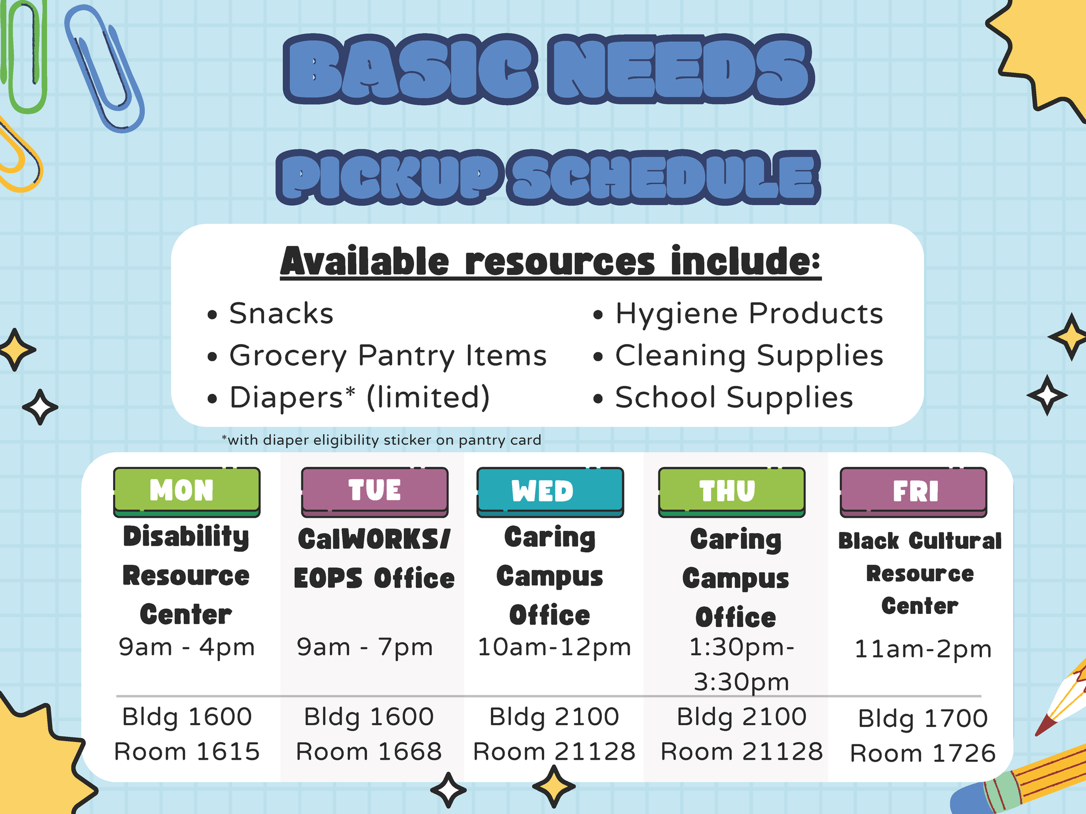
Basic Needs this Fall

Slide 8


Good News...

Slide 9

Resources at LPC
Assessment Center (1642)
Basic Needs Center (Welcome Center, 1600)
Black Cultural Resource Center (1726)
Career & Transfer Center (1604)
Computer Center (21206)
Cultural Community Center (2401)
Disability Resource Center (DSPS) (1615)
English Center (1st floor 2100 Bl)
EOPS / CalWORKs / CARE / NextUp (1668)
Health and Wellness Center (1710)
Veterans First Program (1310)
Tutorial Center (21215)
Reading & Writing Center (RAW) (Tutorial Center)
Registration Support Center (1672)
Student Life Office (1643)
Las Positas College Student Government (LPCSG) (1643)
Student Clubs (1643)

Slide 10

Food & Housing in the Tri- Valley
Housing
City of Livermore Rental Assistance
Affordable Housing Rental Guide for the Tri-Valley
Dublin Region Homeless Executive
Goodness Village
Las Positas College- Alameda County Housing Directory
Services
Livermore Housing and Human Services Resources
Livermore Multi Services Center
Tri Valley Haven
Domestic Violence Services
Sexual Assault Services
Homeless & Family Support
Counseling & Support Groups
Food Pantry
Thrift Store
Open Heart Kitchen
Vineyard Resource Center
Dublin Food Pantry
St. Raymond Catholic Church – Food Bank

Slide 11


Tell Your Story
Notes:
TELL YOUR STORY REDUX
From: Anita Hossain from First Round. She picked up from the consultancy Innerspace. She uses it to break people out of stale narratives about their jobs and career arcs. First, have people turn to their neighbor and spend two minutes each recounting their life stories to one another. Then apologize, because you’re going to make them do it again. This time, ask them each to tell it in a way that’s totally different from the way they normally would.
“Usually, the first go at this is almost all about work. It’s an automatic script,” Hossain says. “People tell each other where they went to college and their paths through various jobs that got them to this moment. When forced to do something different, they immediately start sharing things they usually never would in a professional setting–and they get really into it.”
“They’ll talk about their childhood or why they actually transitioned jobs–they give the other person a peek behind the scenes of what happened,” she continues. “When we reconvene as a big group, we have a few people share what their partner changed about their narrative and why they found that interesting. It helps people feel like they got to know at least one person beneath the surface level.”

Slide 12
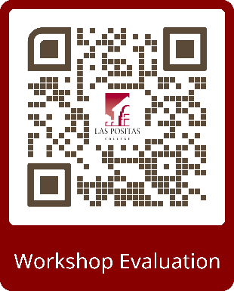

FLEX Day Surveys

Slide 13

Caring Campus Office
Jean O’Neil-Opipari
925-424-1306
joneilopipari@laspositascollege.edu
Building 2100, Room 21128

