Slide 1

Sustainability Projects Update
Zero Waste Initiative Implementation Pilot Project
LPC Academic Senate Meeting
Dr. Matt Kritscher
CLPCCD Sustainability Projects
April 23, 2025

Slide 2
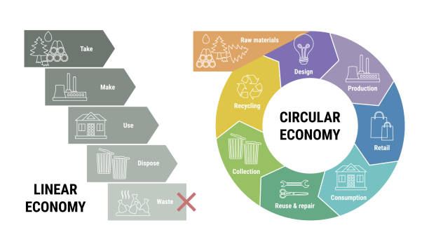

CLPCCD Zero Waste Initiative
Circular Economy and Climate Action Connections
Sustainability & Climate Action Performance Areas Are Aligned with CCC BOG, CLPCCD BP’s and AP’s and College Climate Action Plans to Support a Circular Economy:
    Energy Conservation and Renewable Energy
    Climate/GHG Emissions Reduction
    Transportation Emissions Reduction
    Water Conservation and Recycling
    Waste, Recycling and Compost (Organics)
    Green Building Design & Construction (LEED/GBC)
    Business/Procurement Practices & Policies
    Academic Curriculum and Instruction
    Communication, Outreach and Engagement
    Environmental and Social Justice
    Sustainable Grounds Management
    Board Policy and Administrative Procedures

Slide 3
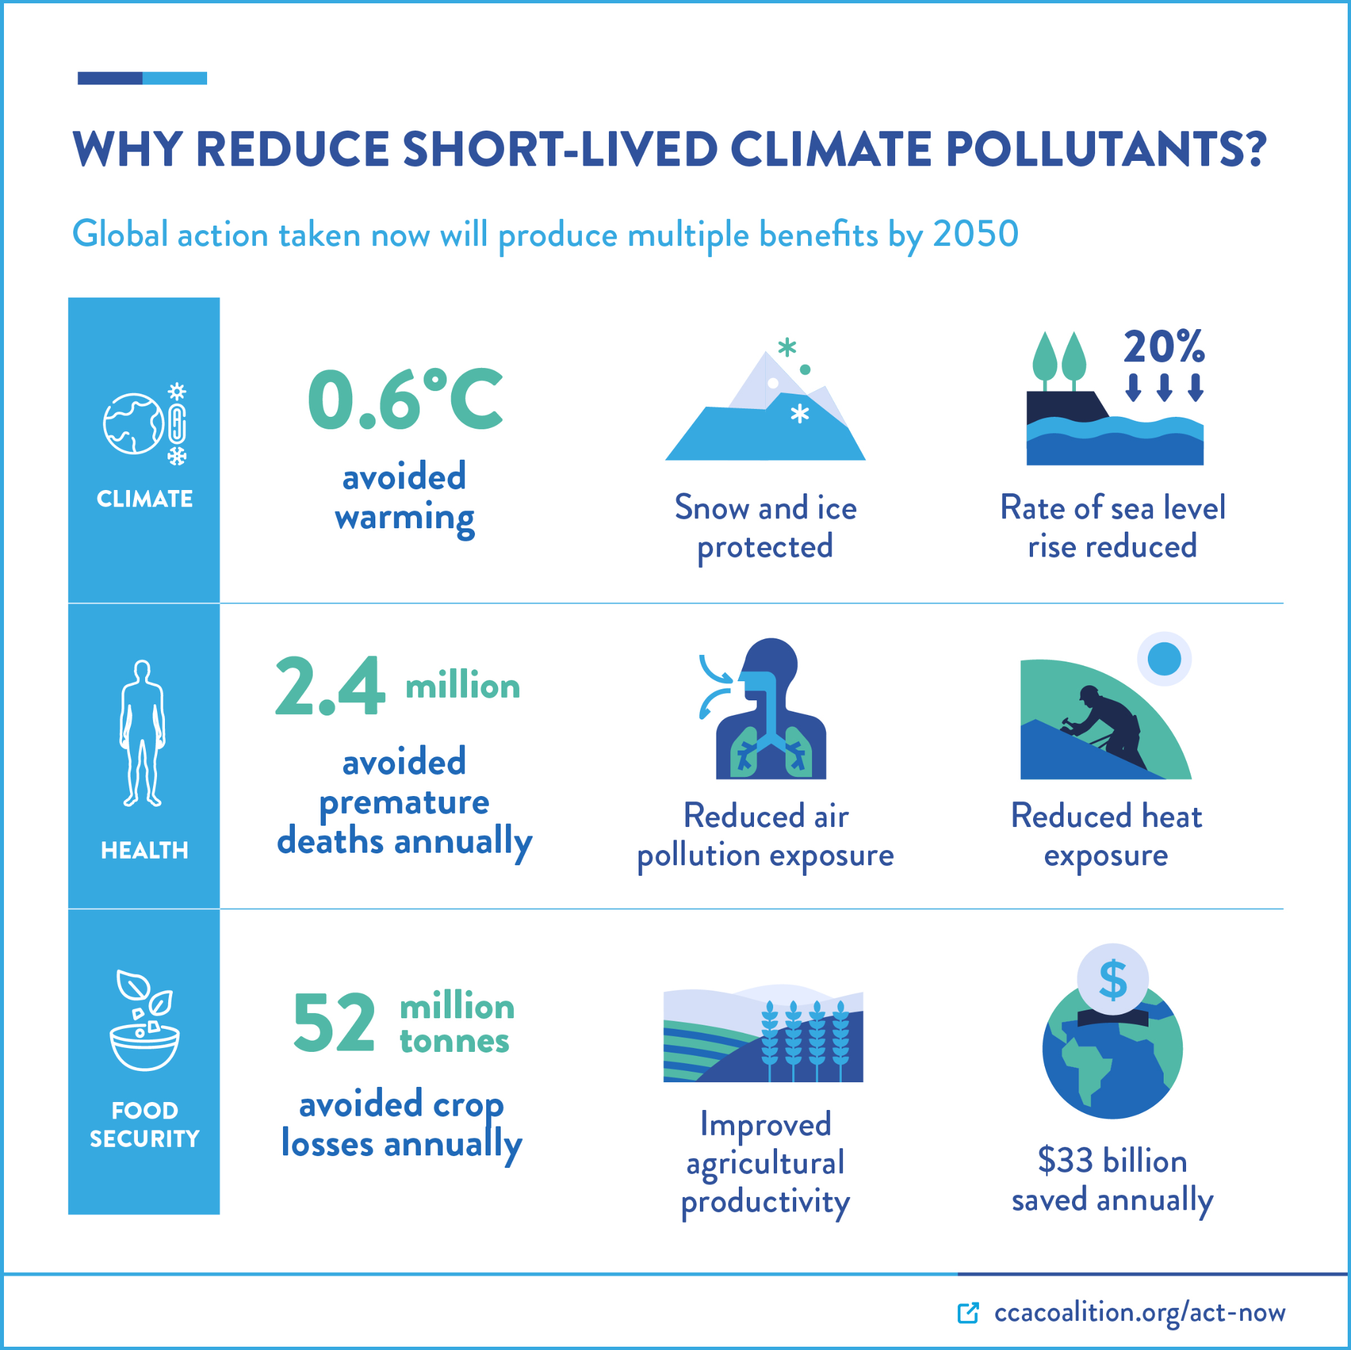
SLCP Climate Imperative:
The short-lived climate pollutants black carbon, methane, tropospheric ozone, and hydrofluorocarbons (HFCs) are the most important contributors to anthropogenic global warming after carbon dioxide, responsible for up to 45% of current global warming.
SLCP Resources:
https://www.c2es.org/content/short-lived-climate-pollutants/
https://www.ccacoalition.org/content/short-lived-climate-pollutants
CalRecycle: https://calrecycle.ca.gov/organics/slcp/

Slide 4

California’s Short-Lived Climate Pollutant Reduction Strategy
Fight Climate Change by Recycling Organic Waste
To reduce methane pollution and other short-lived climate pollutants, California passed SB 1383 (Lara, 2016).
The law set targets for 2025:
75% less organic waste sent to landfills.
20% of unsold, still-edible food sent to food recovery organizations.
Organics like food scraps, yard trimmings, paper, and cardboard make up half of what Californians dump in landfills
Landfills Are Third Largest Source of Methane in California
Organic waste in landfills emits:
20% of the state’s methane, a climate super pollutant that heats 84 times more than carbon dioxide.
Air pollutants like PM 2.5, which contributes to health conditions like asthma.
Cutting short-lived climate pollutants can have the fastest impact on the climate

Slide 5
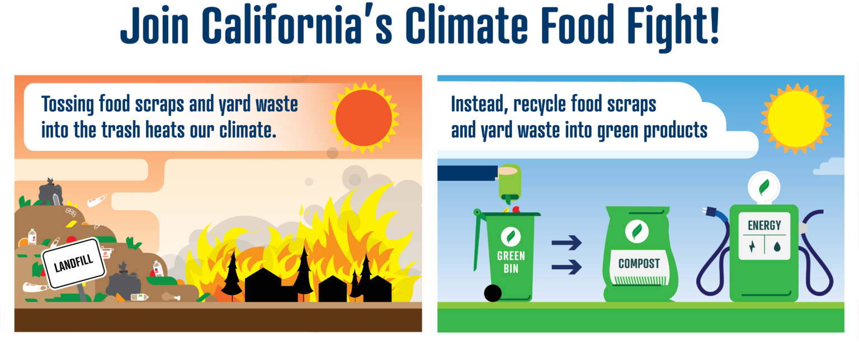

Slide 6
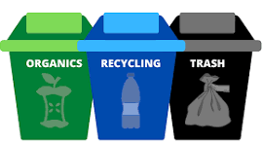
Composting Requirements set in State and County Law
The State of California (SB 1383) and Alameda County local ordinance require businesses, schools and government organizations in Alameda County to separate Recyclables and Organics from garbage. Enforcement activities began January 1, 2024.

Slide 7

Turning the Waste Ratios Upside-Down
5 R’s: Refuse, Reduce, Reuse/Restore, Recycle, Rot
Most of the discarded materials at our campuses and district offices are recyclable or compostable
Ratios should be 75-90% composting and recycling first, 10-25% landfill at most
Recycling and composting help our environment by conserving impacted natural resources and reducing energy use, pollution, and Greenhouse Gas (GHG’s) emissions
Food waste that is sent to the landfill produces Methane gas that produces over 20-80 times the greenhouse gases as Co2 depending on the timeframe

Slide 8


Zero Waste Initiative Implementation
Integrating Organics into Three Stream Waste Sorting, Collection and Processing
Improving waste bin color coding consistency and signage, outreach, district/campus community engagement, and compost-climate education
Pilot Project Phase I: Campus Student Center Kitchens > Cafeterias > Markets > Resource Centers
Phase II: Bathrooms, Breakrooms, Additional Resource Areas
Phase III: Meeting Rooms, Campus Events, Rental Groups

Slide 9
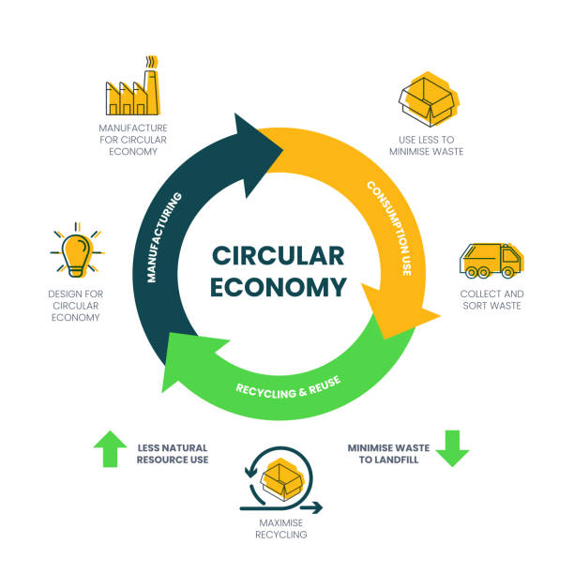
Zero Waste Initiative Performance Goals
Divert 90% of pre- and post-consumer Organic waste from the Student Center (Kitchens, Cafeteria, Quad), Basic Needs and Resource Centers, as well as Break Rooms and Bathrooms district-wide;
Decrease Recycling contamination by 50%; and
Decrease Landfill tonnage by 25%.
  Projected $15k-$20k annual savings district-wide

Slide 10
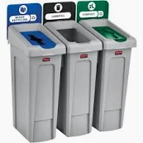
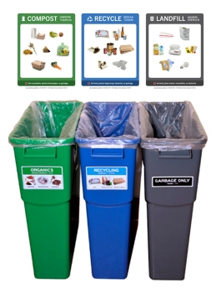
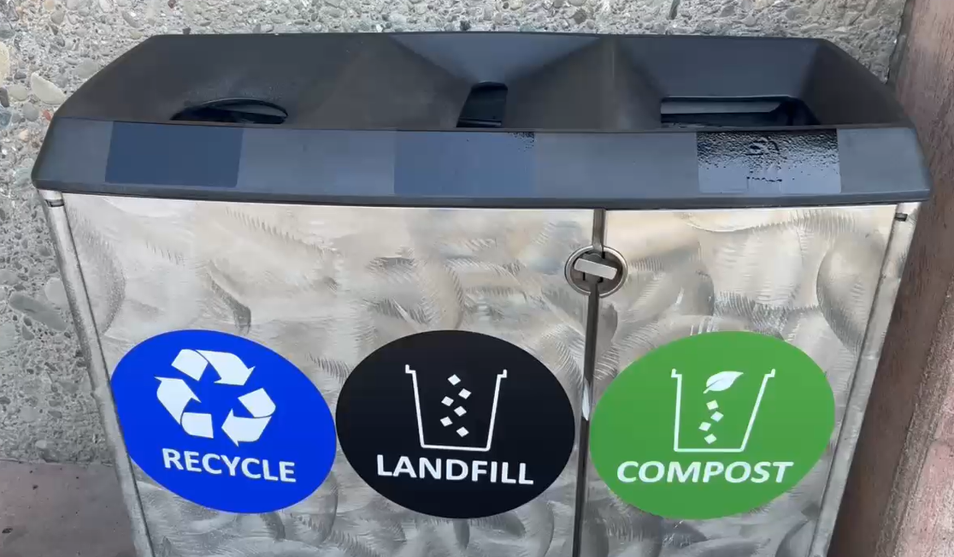
Three Streams Waste Sorting - Color Coded
Composting/Recycling/Landfill Stations
Green = Compost/Organics
Blue - Mixed Recycling
Grey - Landfill

Slide 11

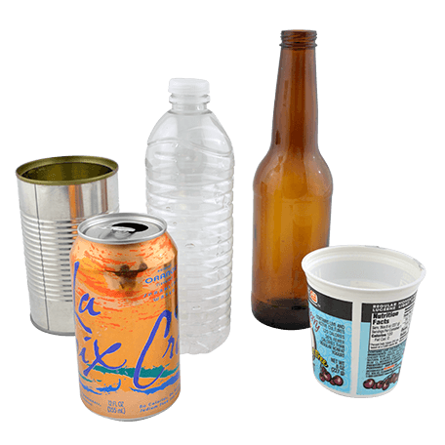

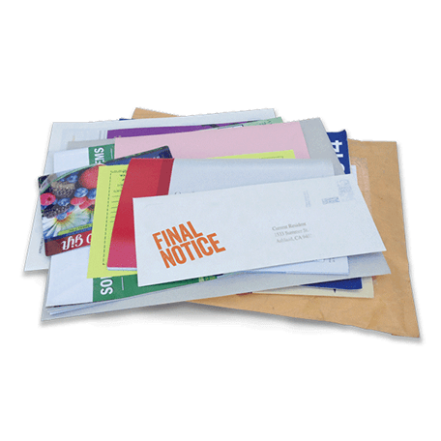
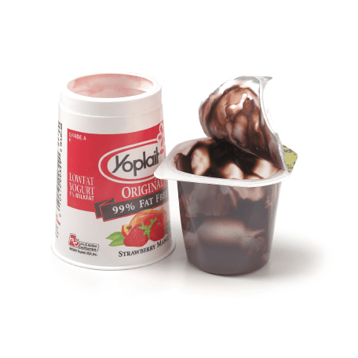
Multilingual Color Coded Signage &
Item Pictures for Sorting Support
Leveraging Free Resources
through Alameda County’s
StopWaste.org (Chabot),
Livermore Sanitation (LPC) and
Amador Valley Industries (Dublin):
Signage templates & stickers
$500 Bin Grants
In-person Training & Videos
Consultation services

Slide 12
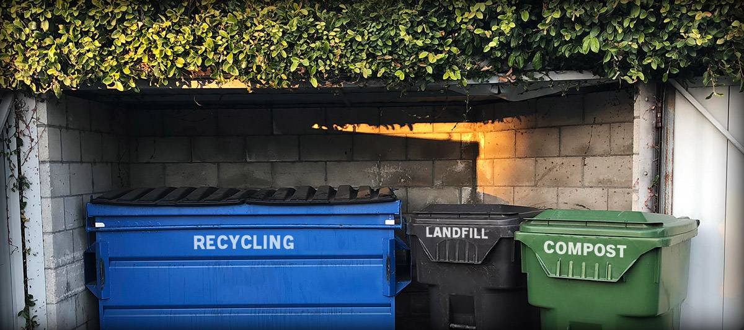
Compost Collection Services Established 3.26.25 at campuses
Thank you M&O and Custodial Services!
Under state and local law, all sites must have compost and recycling service.

Slide 13
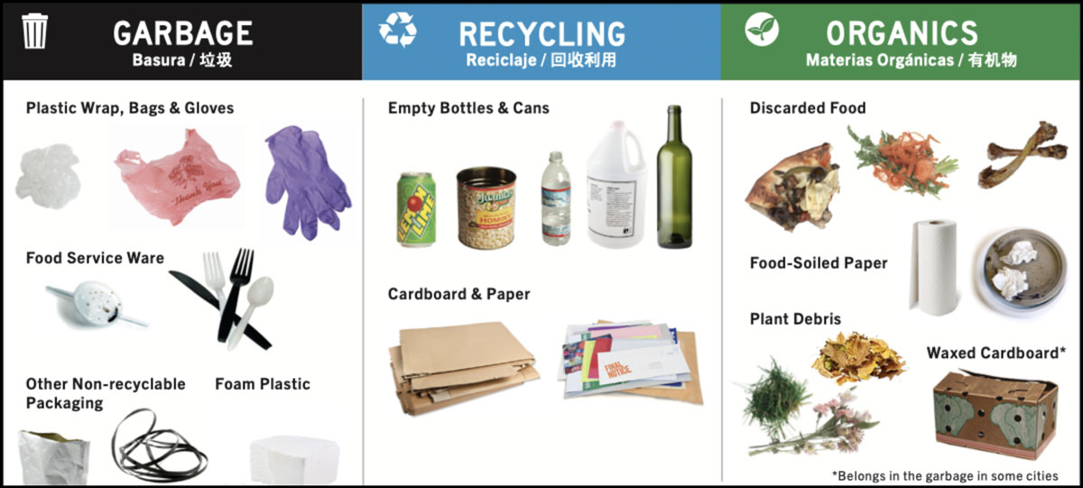
Three Streams
Three Stream Sorting for Triple Bottom Line Outcomes

Slide 14
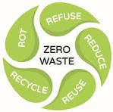


Zero Waste Initiative Resource Development Activities
Submitted California Climate Fellows Host Partners Application
  Applied for 3 Fellows - Integrated team with one for each site (Chabot, DO, LPC)
  $40,000 stipends/education awards paid through grant
  Conditionally Approved! Board Agenda Item Request for May 20th
Submitted Altamont Education Foundation Project Grant Applications
  Requested $40,000 for Chabot and $40,000 for LPC = $80,000 total request
  Response by May 1, 2025

Slide 15
Questions?
Feedback?
What Will You Do To Support Our Zero Waste Goals?
Thank you!

